Slide 1
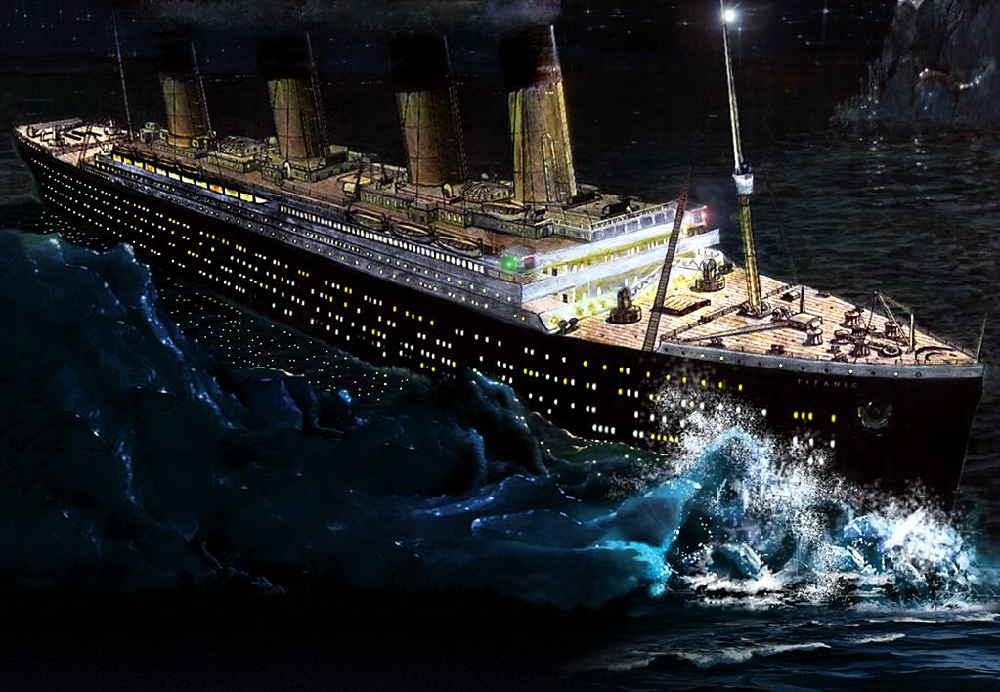
When the Hospital is More Than a Week Away
U.S. Merchant Marine Academy
Emergency Medical Services

Slide 2
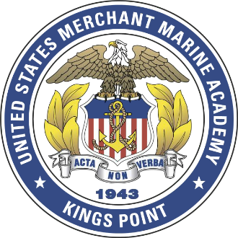
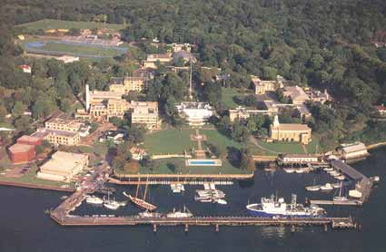
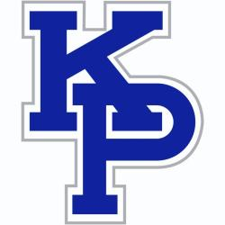
U.S. Merchant Marine Academy
Quick demographic – 82 acres located on the Long Island Sound outside of NYC
1000 students, 750 on campus at any time
Academic year divided into trimesters
Sea Year: a full year out at sea
Half the class of 2nd and 3rd class m/n at sea

Slide 3
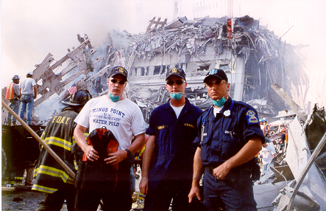
History of the USMMA EMS Squad
Started in 1977 by two midshipman as an ambulance service
1983 First Class to have a certified NYS EMT-B
1990 Made the NYS EMT class an official class.
Respond to all medical emergencies on campus, as well as major events such as September 11, 2001 and Hurricane Sandy in 2012
Notes:
Do other Maritime Academies have EMS squads/medical training?

Slide 4
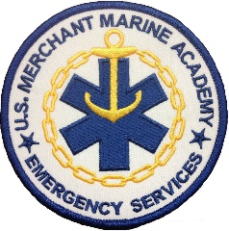
Current Standing
Federal Agency that follows New York State Department of Health rules and regulations
Respond to about 200 calls per year
About 100 members on the EMS squad
All members of the squad are New York State certified EMT-B’s
All members are required to join Great Neck Vigilant Fire Co. as auxiliary members

Slide 5
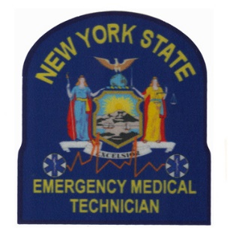
New York State Training
During their freshman year, plebes are invited to apply for the EMT class and about 40 from each class are selected
Selection process is based on academic standing as well as regimental standing
Classes run from November to May
Upon receipt of their EMT certification, midshipmen are now part of the USMMA EMS squad

Slide 6
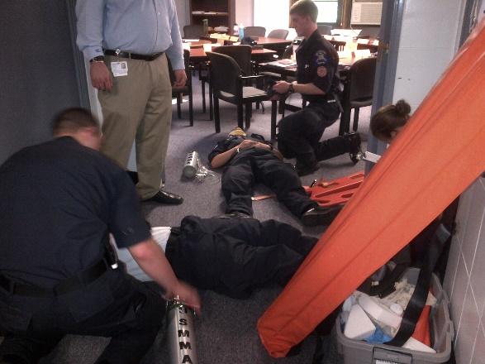
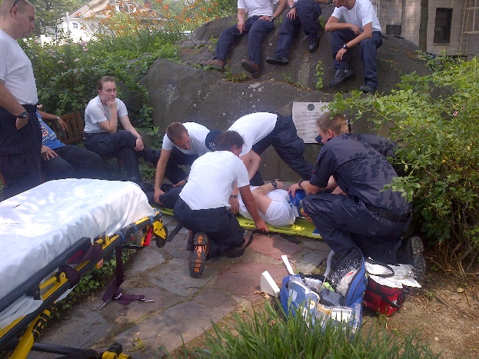
Continuing Medical Education
Train the Trainer – New graduate EMTs to provide medical support for the annual Indoctrination program
Weekly Lunch Trainings
Super Training Day each trimester
Continuing Medical Education seminars

Slide 7
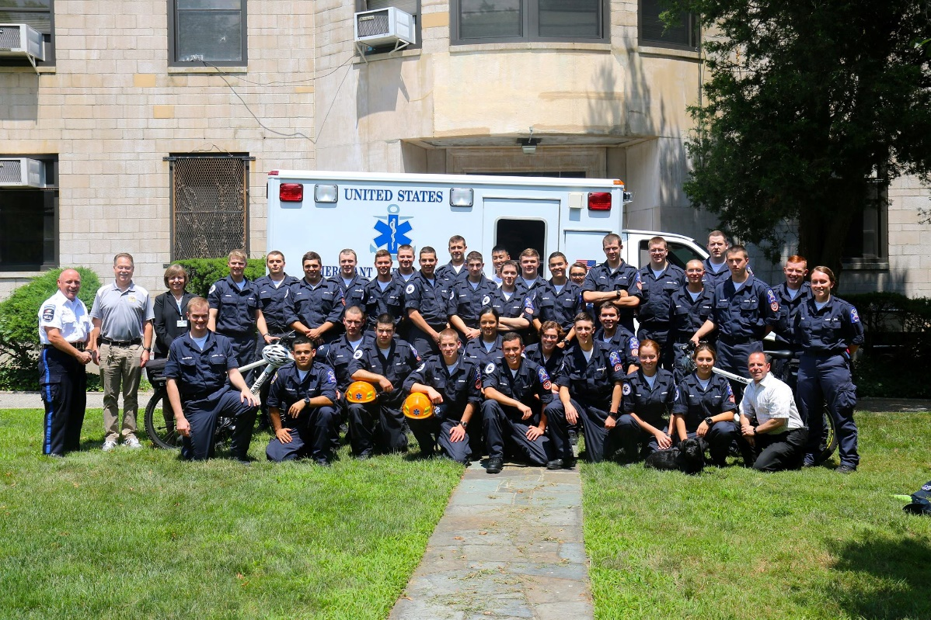
EMS Squad at the Academy
Annual Indoctrination Program – Provide Medical Support (Emergent and non-emergent)
Yearly Operations – Provide BLS response/transport
2013 Responded to
207 calls, 120
transports

Slide 8
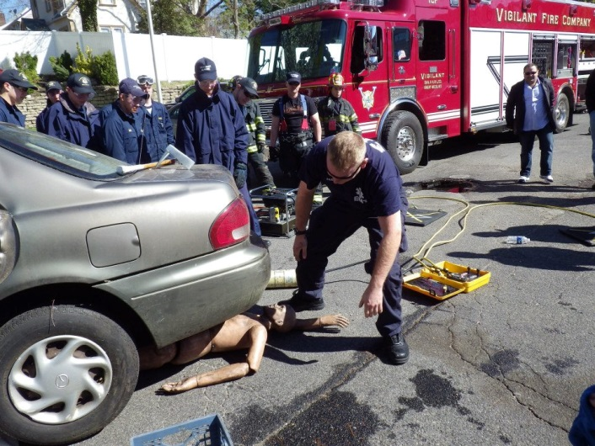
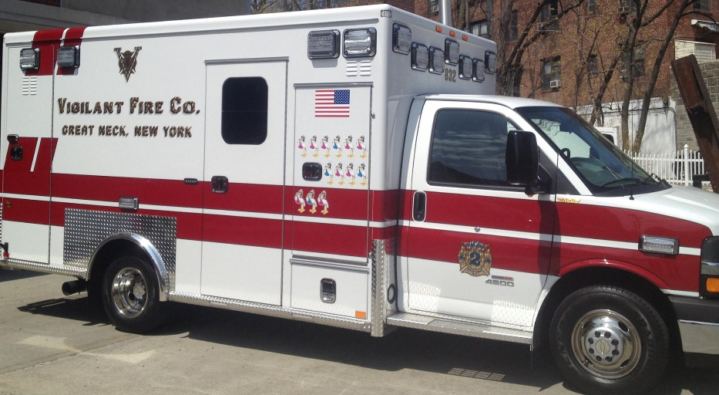

Vigilant Fire Company
Community service as auxiliary members of a volunteer fire service
2013 Year: responded to 1603 alarms, 8295 hours on call
Calls: Falls, Trauma, Heart Attacks, Auto Accidents

Slide 9
USMMA EMTs as an Asset at Sea
All EMTs are required to take the Ships Medicine class
We are a valuable resource to the 2nd Mate as an EMT
Experienced in pre-hospital care in an uncontrolled environment
Provide valuable firsthand experience in providing patient care in stabilizing patients injuries

Slide 10
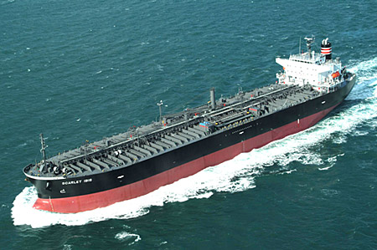
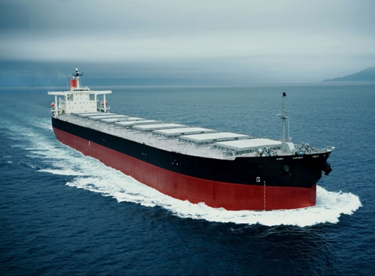
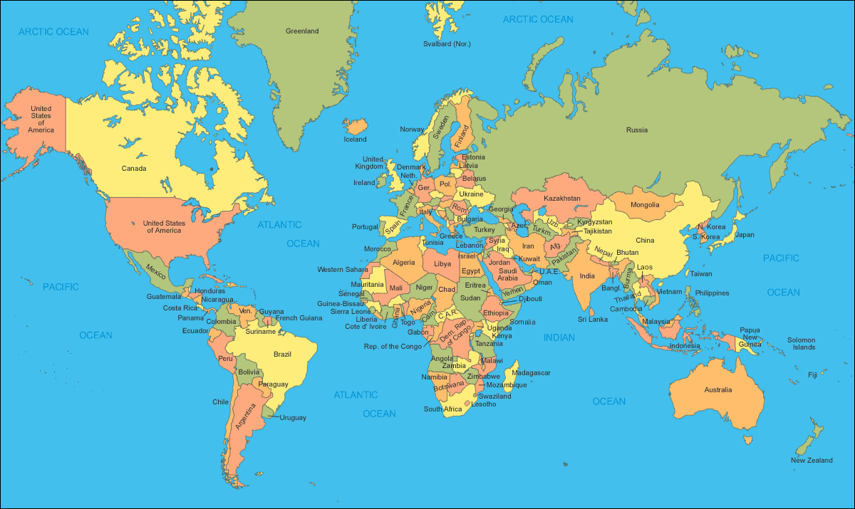
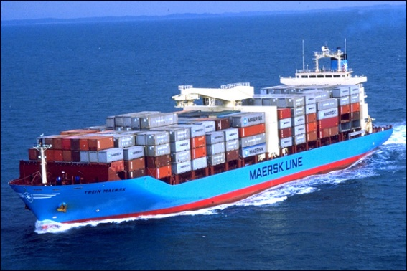
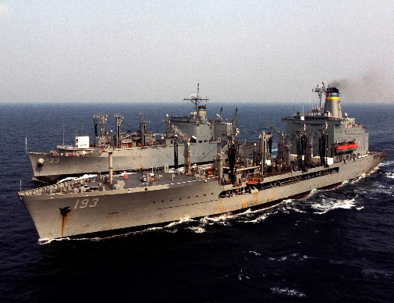
Experiences Around the World

