Slide 1
Turnabout and Fairplay
The Xenophobic Roots of the Jones Act
Joshua M. Smith, Ph.D.
U.S. Merchant Marine Academy

Slide 2
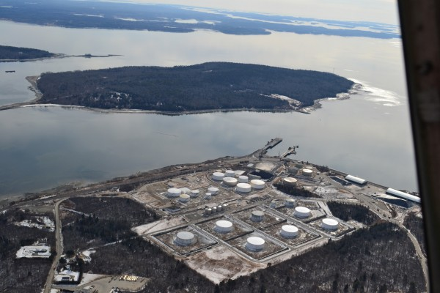
Winter 2013-2014
Mack Point salt

Slide 3
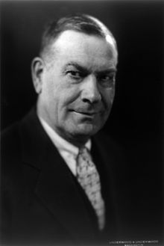

Senator Wesley Jones
Republican Senator
“Zeitgeist” circa 1920
Fairplay magazine

Slide 4
Merchant Marine Act of 1920
It is necessary for the national defense and for the proper growth of its foreign and domestic commerce that the United It is necessary for the national defense and for the proper growth of its foreign and domestic commerce that the United States shall have a merchant marine of the best equipped and most suitable types of vessels sufficient to carry the greater portion of its commerce and serve as a naval or military auxiliary in time of national emergency, ultimately to be owned and operated privately by citizens of the United States.e and serve as a naval or military auxiliary in time of national emergency, ultimately to be owned and operated privately by citizens of the United States.
Preamble
Cabotage
Mariner Safety
Other?

Slide 5
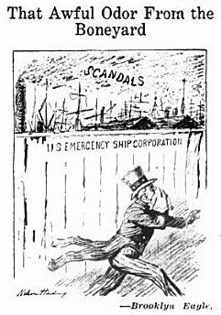
Post-War Milieu
Zeitgeist

Slide 6
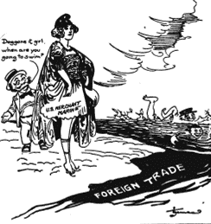
A New American Fleet
New American interest/confidence in foreign trade
Government control v. private enterprise
Government-built fleet
Commerce Committee
“Still Posing.” The American public
by 1921 was asking when the expensive
merchant fleet built with tax dollars was going
to actually engage in blue water foreign trade.
Japan and Britain are seen already swimming.

Slide 7
Process
Senate
CNO input
Maine connection?
Last minute passage

Slide 8
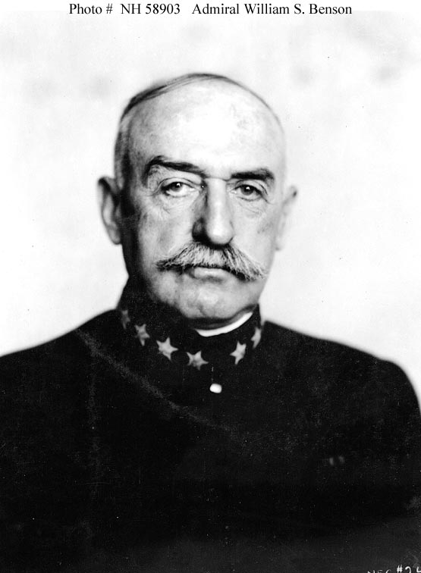
Allies
William S. Benson
  First CNO (1917-1919)
  Anglophobe
  Shipping Board

Slide 9
The New Mercantilism
Philippines
Railroad preference
Treaties

Slide 10
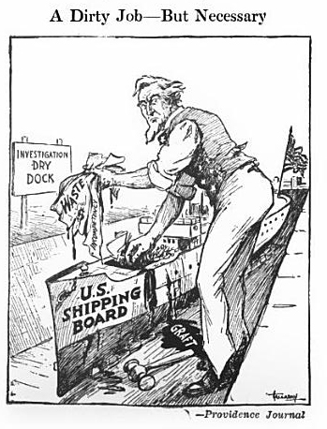
Conclusions

