Slide 1
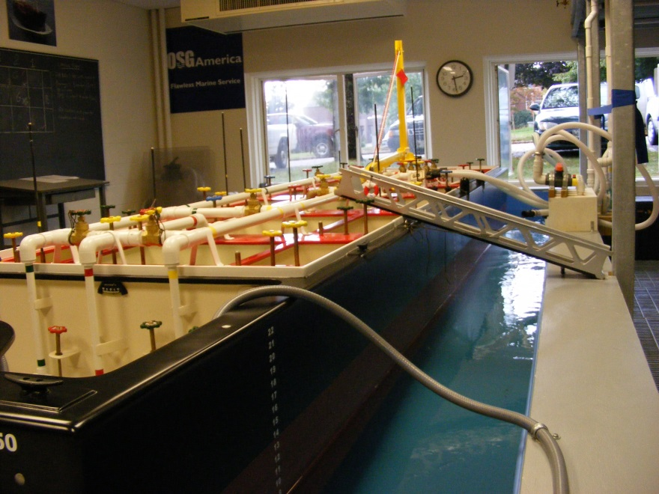
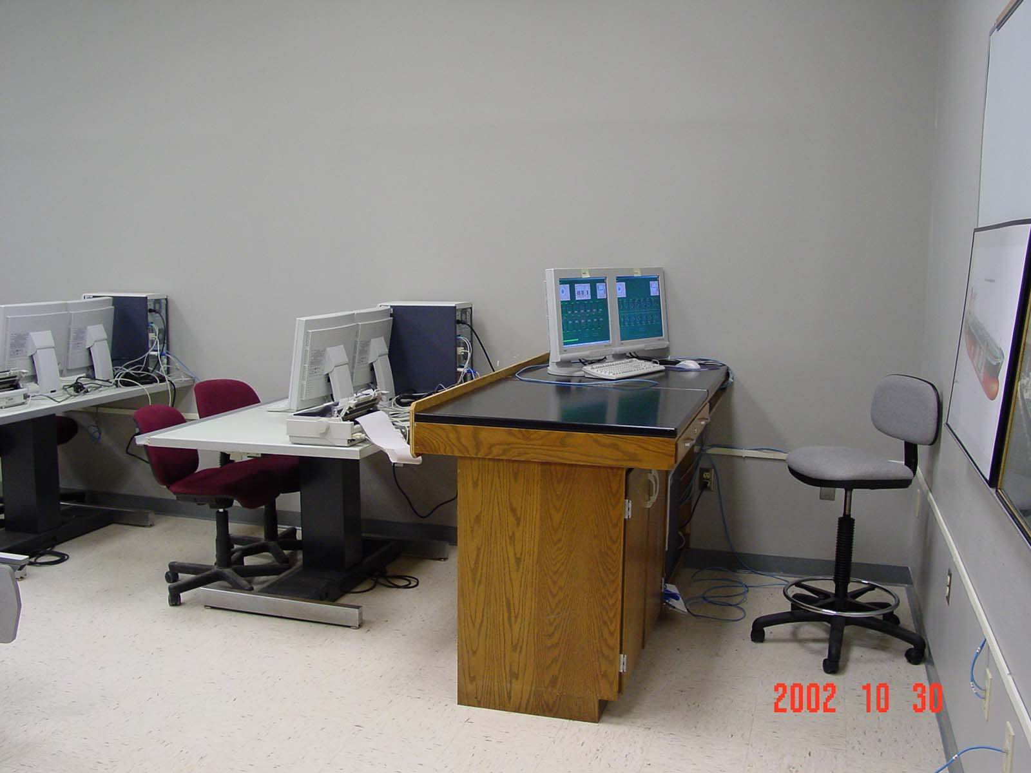
Effective Tanker Training
A comparative study of simulation technologies
Presented by Captain Ralph Pundt
Maine Maritime Academy

Slide 2
There are many impressive training tools on the market today, without which we would not be able to meet the requirements of STCW.
Institutions must invest in these high tech training tools to remain compliant and relevant as a world class Maritime Training Institution.

Slide 3
The trick is to blend the educational value of a simulator with the abilities of the students.
Students have a knack for technology and can quickly learn to “manipulate” complex systems. Without gaining a true understanding of the reasoning or direct cause and affect of the process.
is happening?

Slide 4
Learn to crawl before you walk
Dangerous cargo simulators are no different.
They are very useful in developing a strong reinforcement and an advanced understanding of the complete cargo operation.
They can however overwhelm novice students
Numbers and flashing lights have no meaning unless the students can relate to their meaning.

Slide 5
Educational Objectives
STCW and USCG mandate the basic requirement for a dangerous liquid cargo course.
But novice Students must gain a stronger fundamental understanding of basic cargo flow, the effect of improper weight distribution on a floating vessel, and proper cargo system lineup.
Must develop stronger leadership and communication skills, and understand the value of a positive team effort .

Slide 6
Basics of a DL course
In addition to the USCG/IMO course requirements the class outcomes should include:
Learn to develop and execute a well defined cargo plan.
Learn to develop and visualize proper cargo flow techniques
Learn to work within a command structure
Learn to effectively communicate
Learn to work as a cargo team
Understand the cargo system
Learn to work within the limitations of the vessels cargo system
Learn to manage and visualize the weight distribution of the cargo
Learn to task manage, safety considerations such as line handling and gangway safety during cargo operations.
Understand and visualize the effects of their actions
Understand the role of the shore representative
Learn to work within the constraints of the international safety and pollution regulations

Slide 7
Make it as real as possible !

Slide 8
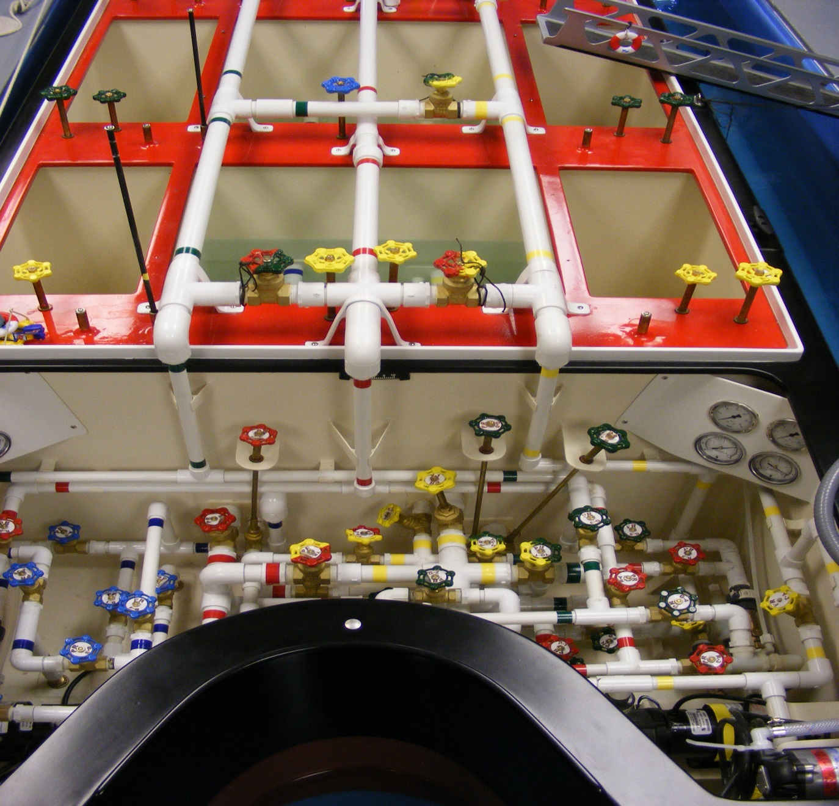
OSG 305

Slide 9
Step One, Learn the system
Develops a clear understanding of cargo system
Pump room Line up
3 centrifugal Main Cargo Pumps
2 Positive displacement stripping pumps
2 Cargo eductors
1 Segregated ballast system
Ballast eductor strippers
Notes:
Talk about the drawing project

Slide 10
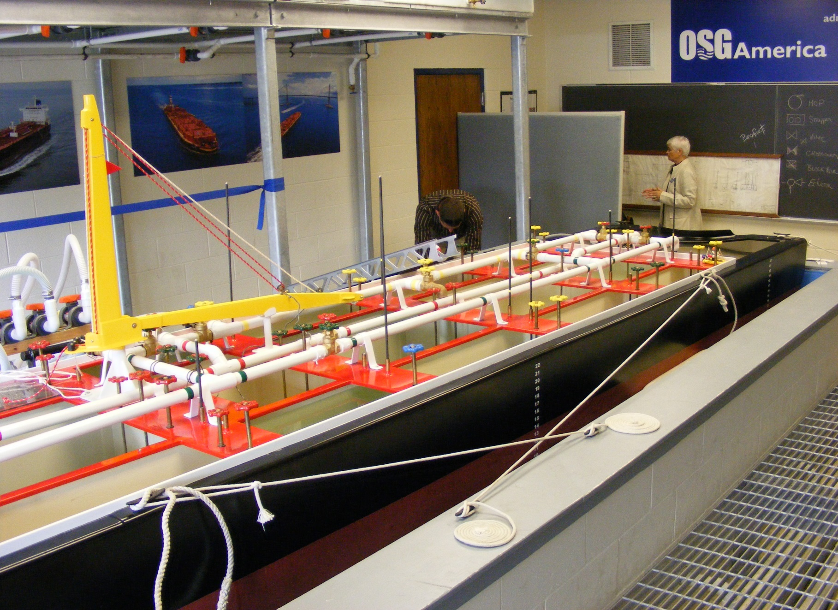
Designed to discharge all cargo in 50 minutes
18’~ 5.48 m loa
2’~ .6m molded depth
4’~1.2m beam

Slide 11
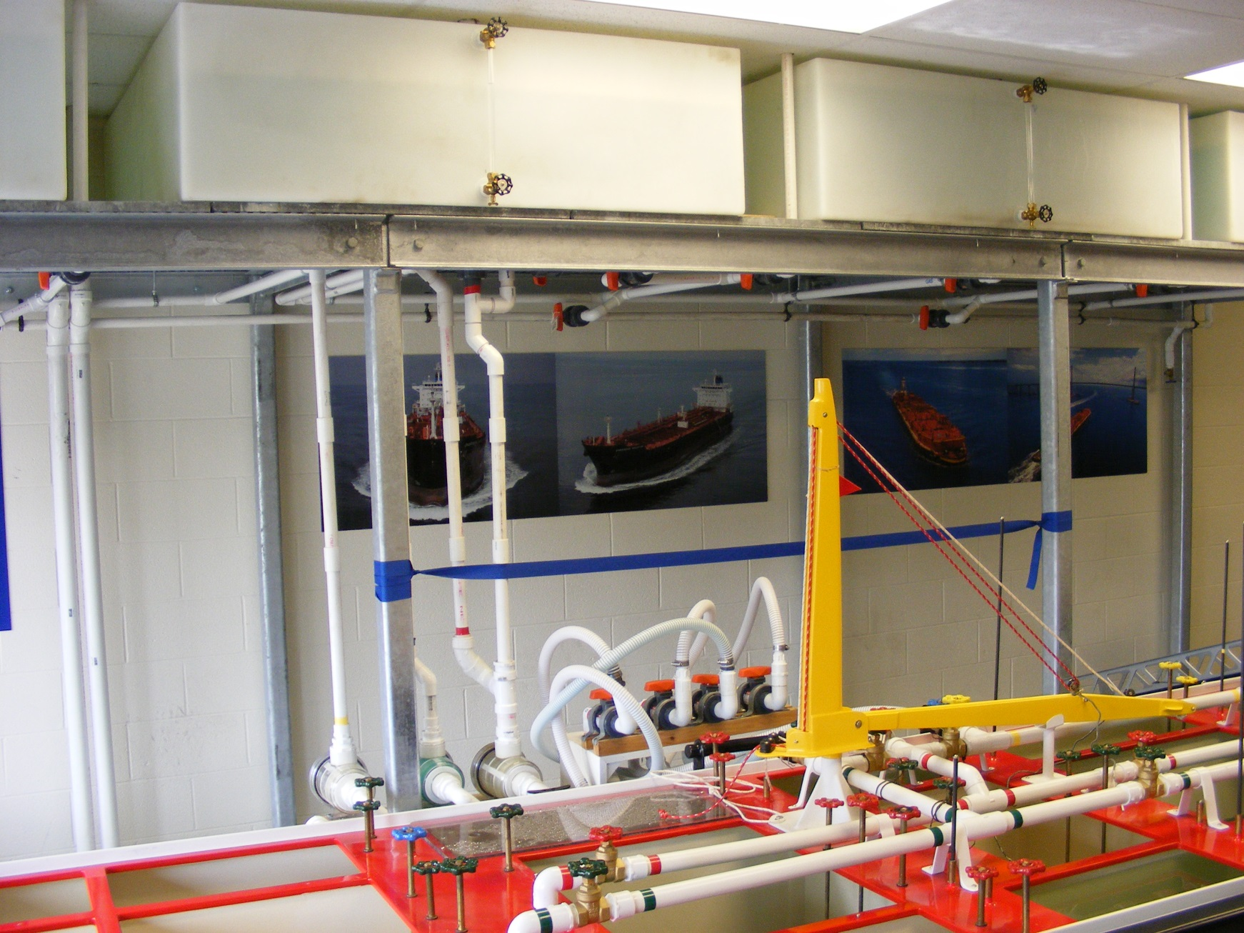
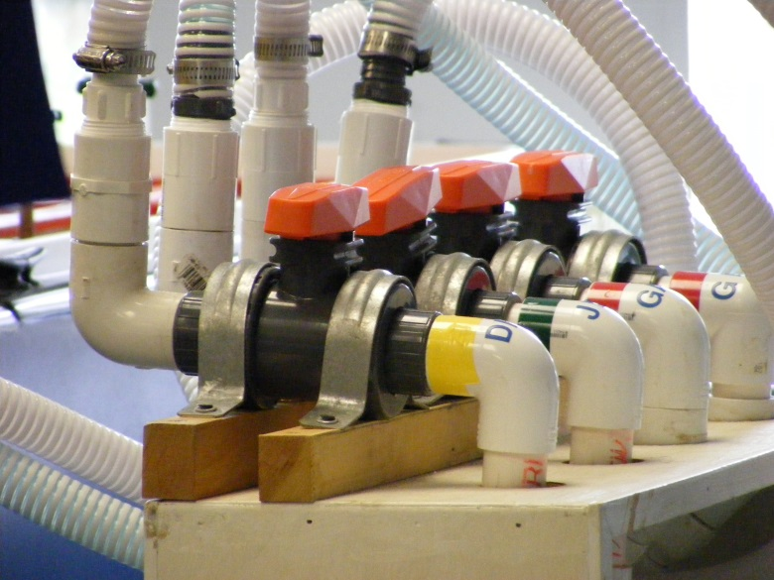
Shore Cargo Tanks
3 separate cargoes from 4 ~ 250 gallon shore tanks

Slide 12
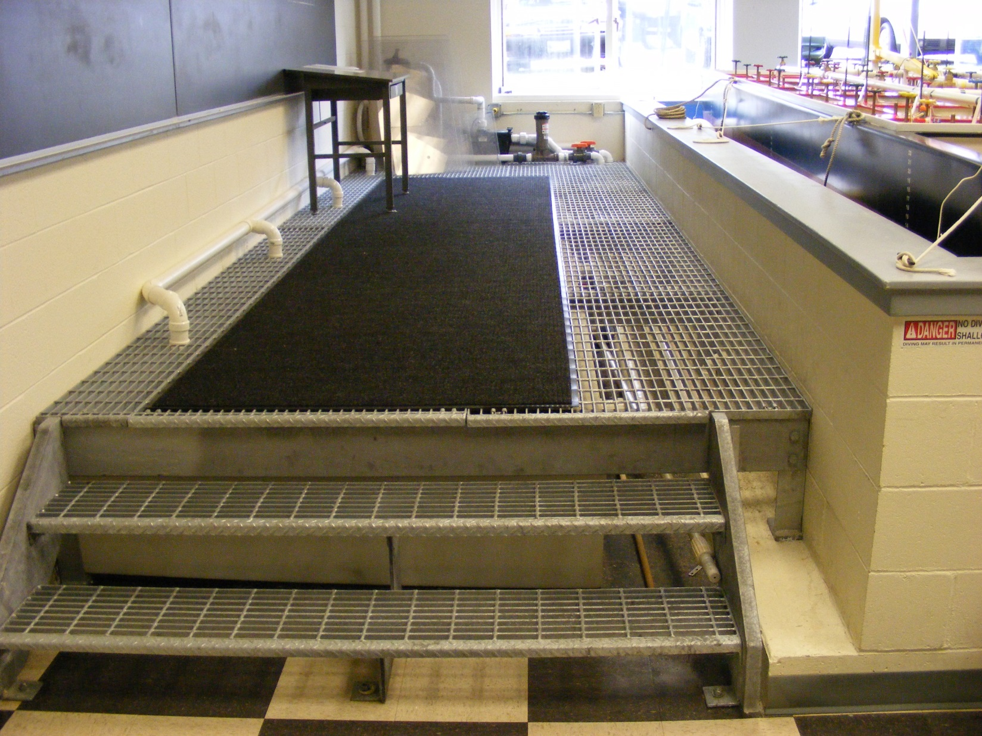
Displacement overflow tanks

Slide 13
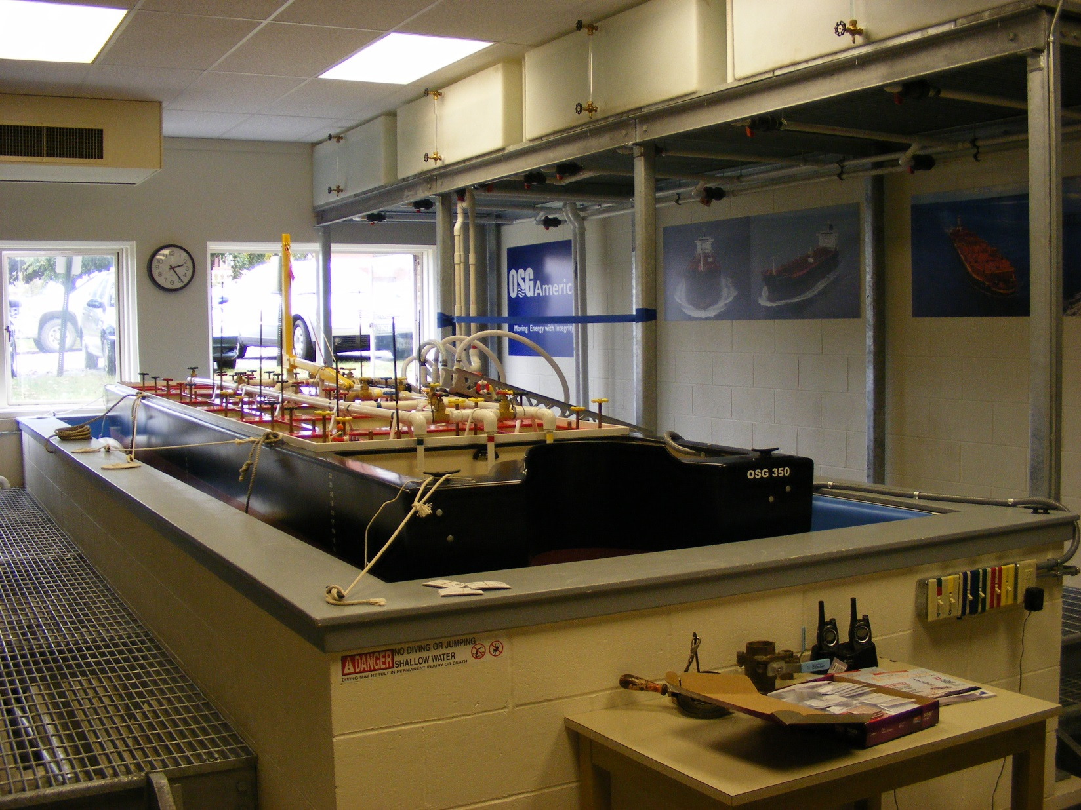

Slide 14
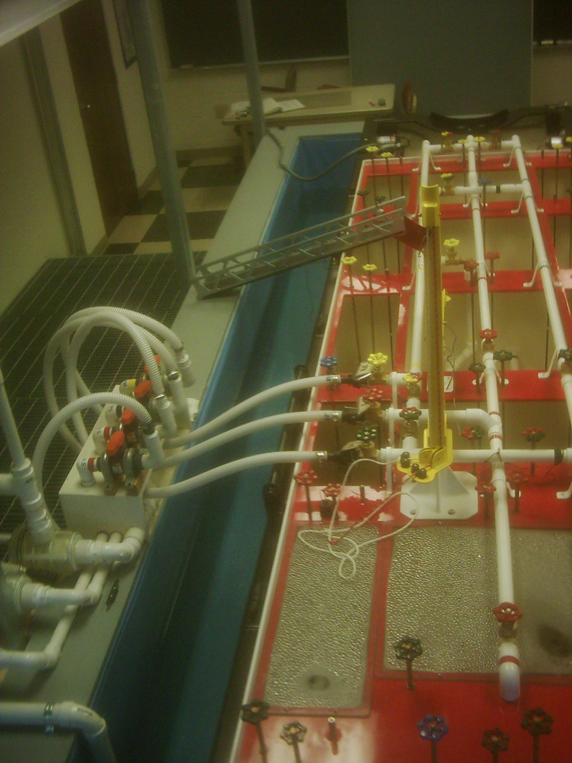

Slide 15
Pump room line up
Notes:
We create our own piping diagram, by tracing the system and developing their own drawing the students have a greater time investment and at the end of the project they have a

Slide 16
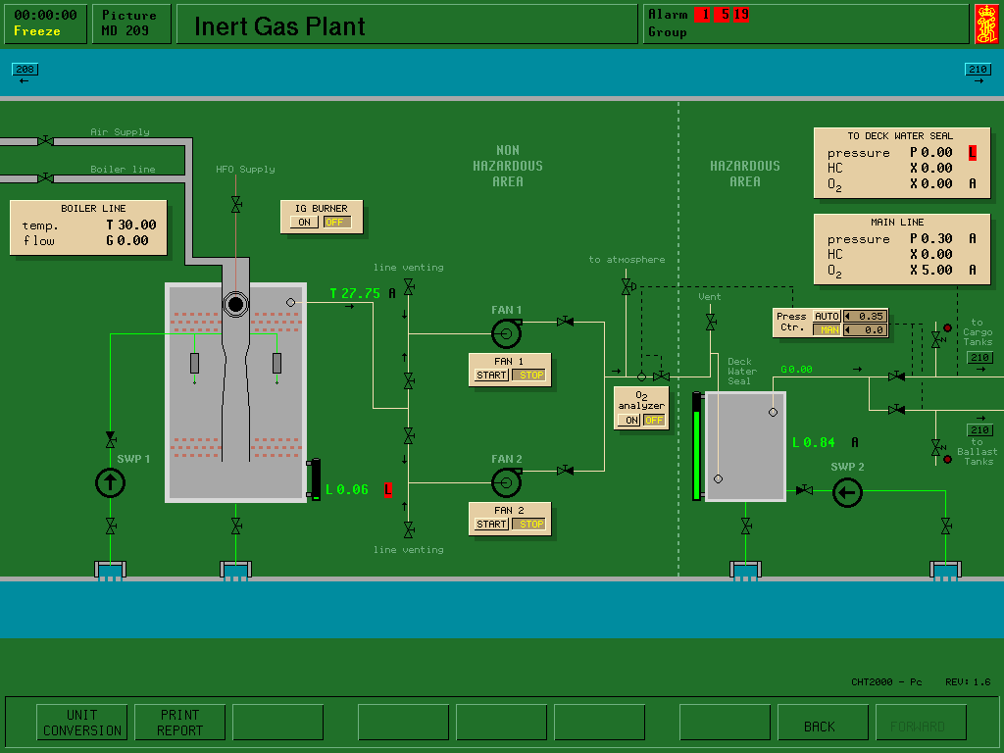
Electronic Simulators ` Pros
Multiple operations
Cargo flow
Inert Gas
Ballast
Crude oil washing
Stress and stability calculations
Theoretical list and trim management
Notes:
Students often don’t recognize a problem in an electronic symulator as they are trying to absorb the meaning of all the inputs
In our system if the cargo is not flowing, it is obvious and the solution is is physical not a potential electronic ‘glitch” which is the first reaction the students have.

Slide 17
Pros ~ Electronic Simulator
Provides a total overview of all systems
Provides the opportunity for the students to control a multi function operation
Stability and stress control
Cargo planning to include multi weighted cargo
Provide a strong understanding of the over operationall management of cargo operation

Slide 18
Floating Model ~ Pros
Visualization of all aspects of the cargo transfer
Multi product top off sequencing
Multi product stripping sequencing
Real cargo flow which reacts to actual flow adjustments and which provides a clear visualization of events as they unfold
Sound : the students can hear and appreciate the sounds associated with the pump room.
Team work skills
Communications skill
Cargo planning skills
Group Dynamics

Slide 19
Pros~ Floating Model
Multi Cargo Transfers
Load and discharge sequence planning
Pumping techniques
Provides clear visualization of cargo transfers
Provides a clear understanding of weight distribution in a floating vessel
Provides an opportunity to develop and work within a positive command structure
Provides a opportunity to develop proper verbal and written commandscommunication techniques

Slide 20
Pro ~ Floating Model
Because they can hear the pumps, the students develop a sense of understanding when air has entered the system.
They learn to appreciate the value of eductors and positive displacement pumps while stripping the tanks
They clearly understand the value of trimming the vessel by the stern to pump out the maximum quantity of cargos
The key advantage is that they can visualize what is happening and develop a keen sense of situational awareness

Slide 21
Electronic Simulators ~ cons
Simulators are not designed to be operated with in a group dynamic.
Cargo and pressure flow is not clearly understood by the novice student, as the depiction of such flow is illustrated numerically. The subtle changes in the system are not apparent to the novice student and is not easily understood until the student has gained more experience
There is no sound associated with the simulation. Students need to understand the language of the pumps and feel the pressures in the system. This can not be done “yet” in simulation.

Slide 22
System Complexity; for a novice student these systems can become overwhelming. Once overwhelmed, the scenario reverts to a video game.
The students must develop an understanding of the fundamentals of the operation before they can learn to multi task in a more complex system.

Slide 23
Model Simulation ~ Cons
Can only simulate cargo and ballast control
Unable to simulate stress calculations
Requires a substantial infrastructure

Slide 24
Cons~ Floating model
Can not determine stresses or initial stability conditions “yet”
Although three cargoes are being loaded they are of equal weights.
There are only two systems to manage
Ballast and main cargo systems
But that is enough and will not over whelm the students

Slide 25
Training Sequence
MMA offers a basic and an advance tanker course.
The basic course primarily uses the floating model while the advance course uses the electronic simulator.
2nd Semester Sophomore – NS 210 establishes the ground work for a positive cadet shipping experience
Cadet shipping/Coop- Experiential on the job learning
Last semester- Ns 412 Advanced tanker operations enhances their accumulated knowledge focusing on tanker management and combined systems operational management

Slide 26
Electronic DL Simulator
It is difficult for the novice student to understand what the numeric associated with pressure, temperature and cargo flow represent.
Although realistic to the operation of modern tankers this system is better served by a student who has a greater understanding of tanker operations than a 2nd year student
It is a great teaching aid for advanced tanker operations, and for students who have completed the basic course and have had the opportunity to cadet ship aboard a tanker.

Slide 27
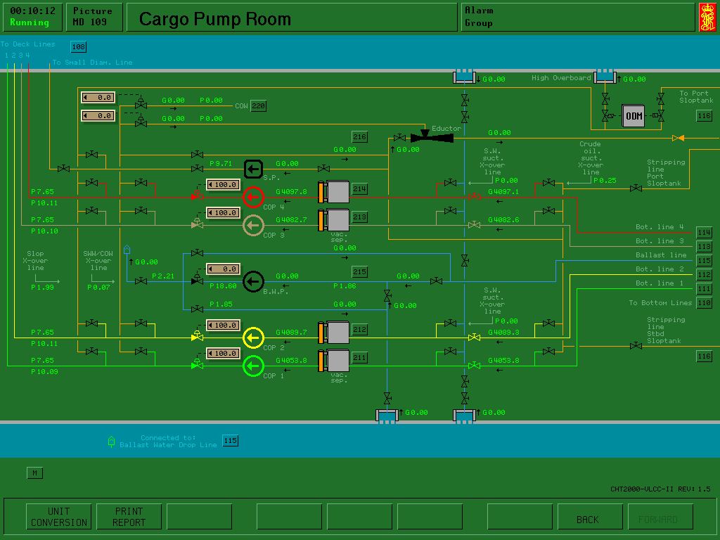

Slide 28
Group Dynamics
A Lab consists of
Person in Charge
Mate on deck
2 seamen
1 Pump man
1 shore representative
1 observer/ log keeper
Notes:
The true value of this system is in developing group dynamics and leadership this is frequesnly the first time students have the opportunity to direct their peers, “giving and following orders” They learn to appreciate the value of a good cargo plan , which they must develop, and how constructive critisisum can help to develop an effective team

Slide 29
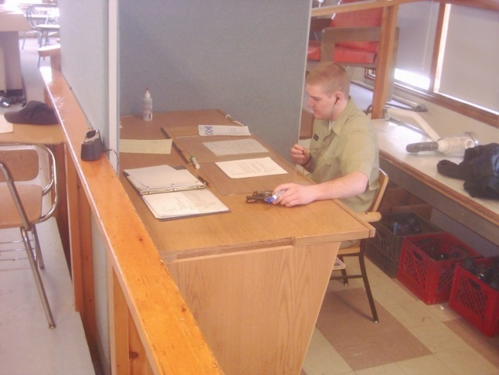
Responsibilities
Title | Job Description | Responsibility
Chief Mate | Over all in charge, develops and executes the load/discharge plan | Over all in charge, responsible to the Captain and charterer (instructor)
Mate on deck | On Deck coordinator | Directly responsible to the Chief mate
2 Able Bodied Seamen | Assist as Directed – Sound tanks- make valve adjustments, handle lines and tend the gangway | Responsible to the mate on deck
Shore Representative / Observer Record keeper | Keeps all logs- takes debrief notes- lines up shore- controls cargo flow | responsible to the chief mate
Pumpman | Lines up and operates all shipboard pumps, conducts ballast operations | responsible to the Mate on Deck
Notes:
Explain the sequencing and objectives of the labs

Slide 30
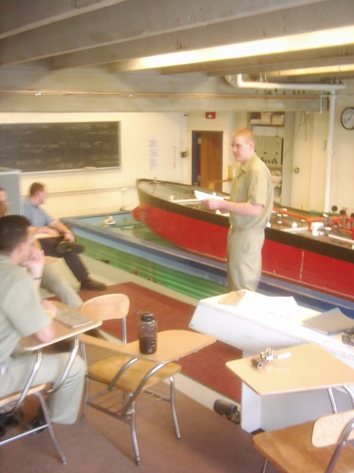
Observer’s Debrief Notes
What worked:
Good Communication between Chief mate and Deck mate (In what way?)
AB's carried out direction as best they could (leads to a discussion for clarity)
Chain of command was understood
Team worked well with each other (In what way?)
Shore communications and use of shores ability to slow flow
What didn’t work:
AB's were left out of the bigger picture, which might have given them a chance to think ahead (leads to a discussion for clarity)
Start and stop times should have been more staggered
Had one safety tank for two types of cargo (weren't used)
Missed valve on initial line up (How can that be avoided?)
AB's were too busy to make judgment when needed (leads to a discussion for clarity)
Improvements:
Need to tend lines
Overall system understanding
Communicating overall picture to AB's
Notes:
No transfer can be started until the safety check list is completed and the oil record book is filled out

Slide 31
Port LOG | OSG 350 |  |  |  |  |  | Date
Arrival/NOR |  | Tugs A/s |  |  |  |  | Tugs A/w
Pilot Ab
All Fast
Com. Inspection
Dry Cert |  | Cargo 1 |  |  |  | Cargo 2 |  |  | Cargo 3
 | Type/Cargo
 | Hoses ON
 | Commence Cargo
 | Stop
 | Resume
 | Stop
 | Resume
 | Finish Cargo
 | Hoses off
 | Cargo Time
 | Total Time
Complete Insp |  |  |  |  | Tugs A/s |  |  |  |  | Tugs A/w
Paperwork Ab
Pilot Ab
Vessel Released
PIC Ship |  |  |  |  | Pic Shore
Ship’s Log
Signature and Date

Slide 32
Conclusions
Students rarely communicate effectively
Verbally, Written, Visually, using radios
So where ever and when ever there is an opportunity to develop these skills use them
We must always challenge our students so that they have the tools and desire to advance their knowledge.
“They don’t know, what they know, until they are challenged”

Slide 33
Thank you
ralph.pundt@mma.edu
Maine Maritime Academy
Castine, Me

Slide 34
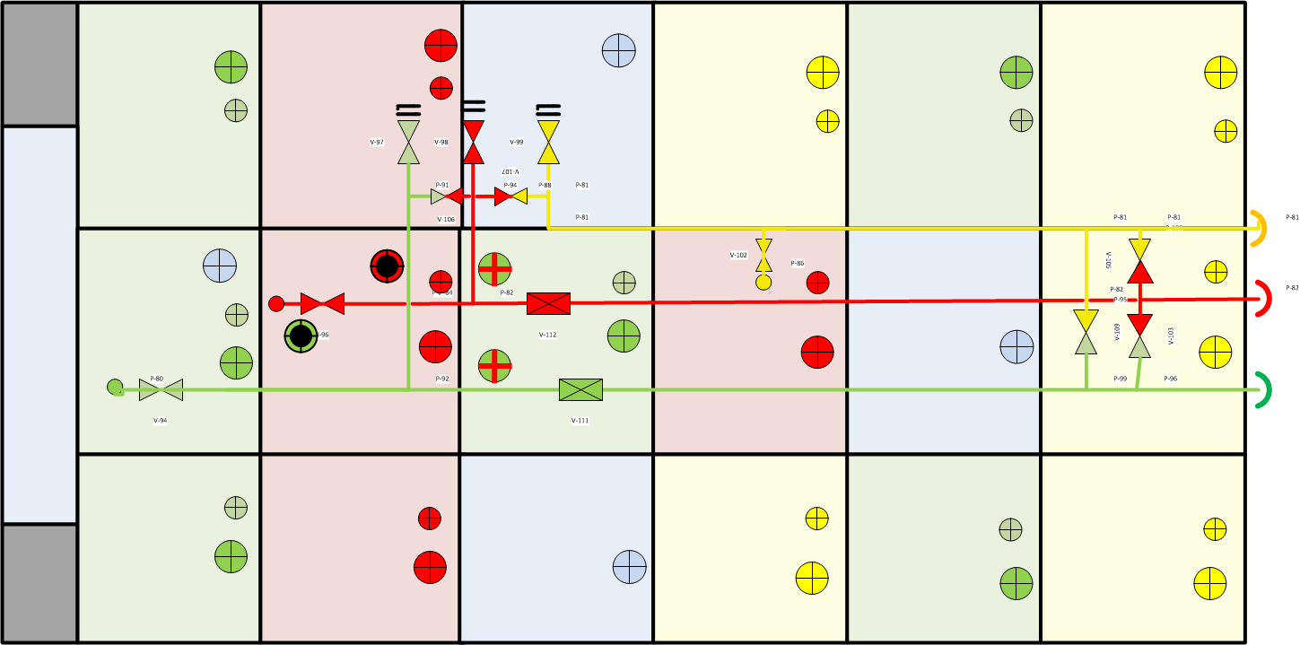
Main Dk Drawing Key

Slide 35
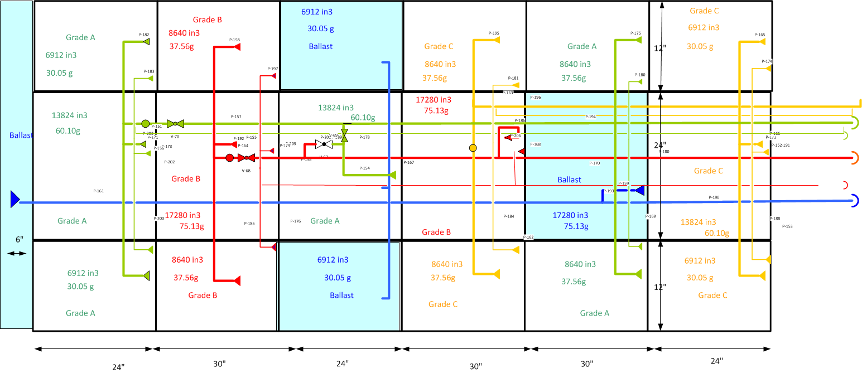
Below deck

Slide 36
Pumproom

