Slide 1
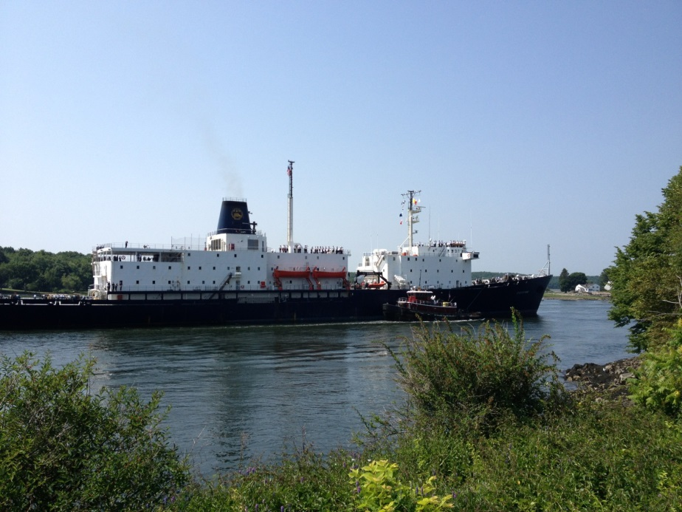

How Can We Improve Maritime Academy School-ship Training in the United States?
Maritime Education Summit - Fall 2014
Mark Libby, Laurie Flood, Lance Burton
Maine Maritime Academy

Slide 2
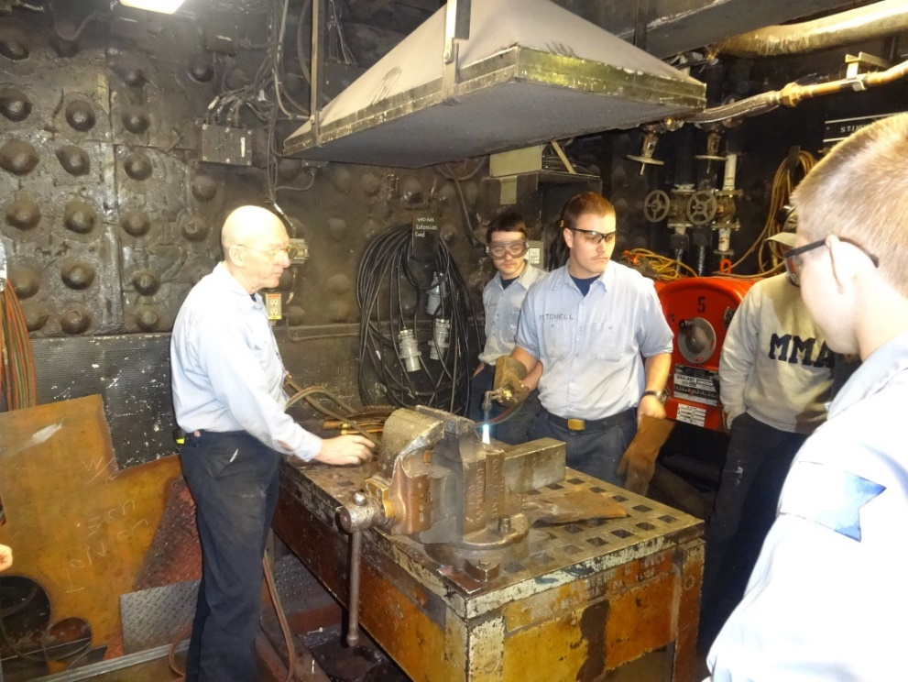
Introduction
The greatest of STCW training emphasis lay with practical competencies.
This can be defined as taking knowledge based material from the class room and physically demonstrating the “how-to” skill via simulation or on an actual piece of equipment.
  The majority of these skills are learned and demonstrated on annual training cruises.

Slide 3
Our students are preforming tasks to meet STCW competencies at two levels:
  Ratings Forming Part of an Engineering Watch (RFPEW)
  Officer in Charge of an Engineering Watch (OICEW)

Slide 4
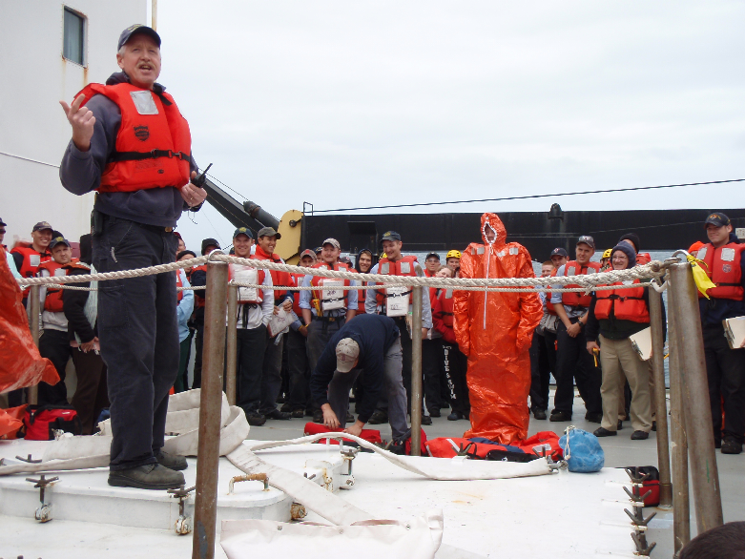
The specific tasks associated with both ratings are numerous.
Most of the training time on cruises is devoted to the instruction and assessment of practical based STCW competencies.

Slide 5
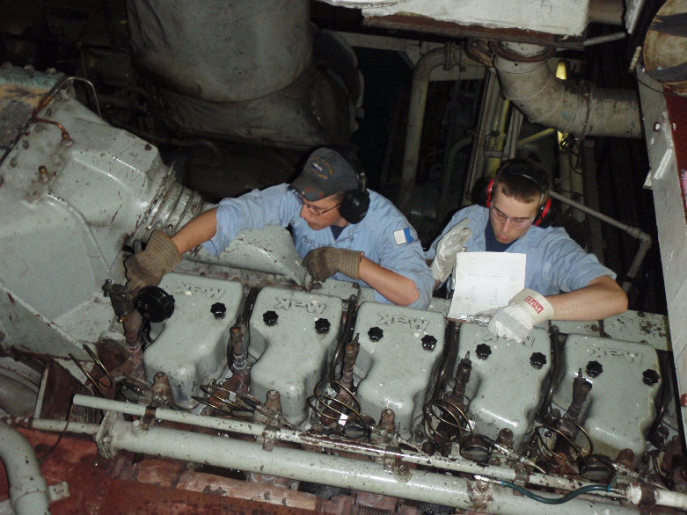
All of the competencies fall into one of four categories:
1. Carry out routine watch duties and communicate effectively in matters related to these duties

Slide 6
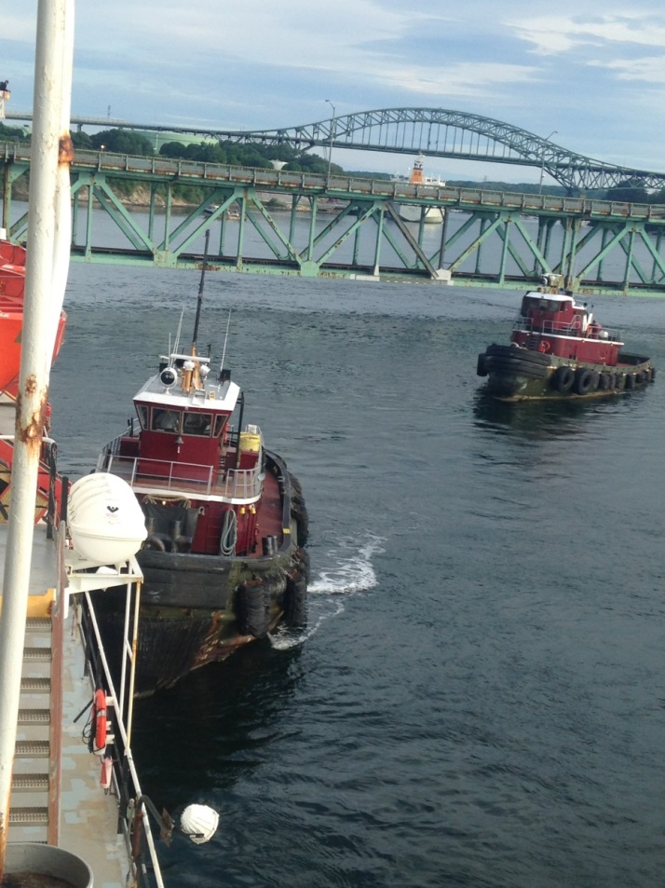
All of the competencies fall into one of four categories:
2. Safe working practices which includes a knowledge of environmental protection procedures

Slide 7
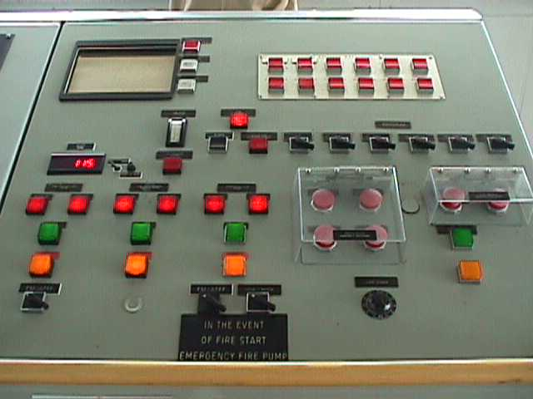
All of the competencies fall into one of four categories:
  3. Understanding engine room alarm and communication systems

Slide 8
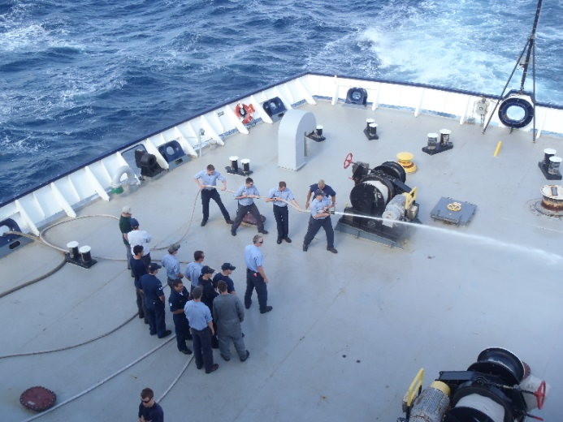
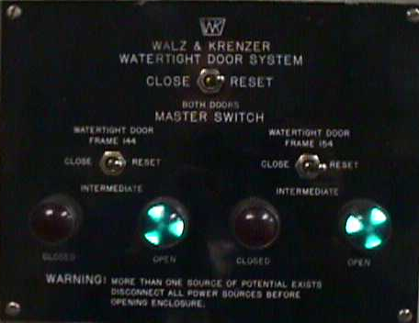
All of the competencies fall into one of four categories:
  4. Operate emergency equipment and apply emergency procedures
    Knowledge of emergency equipment
    Knows the location of escape routes from machinery spaces
    Familiarity and location of firefighting equipment in the machinery spaces

Slide 9
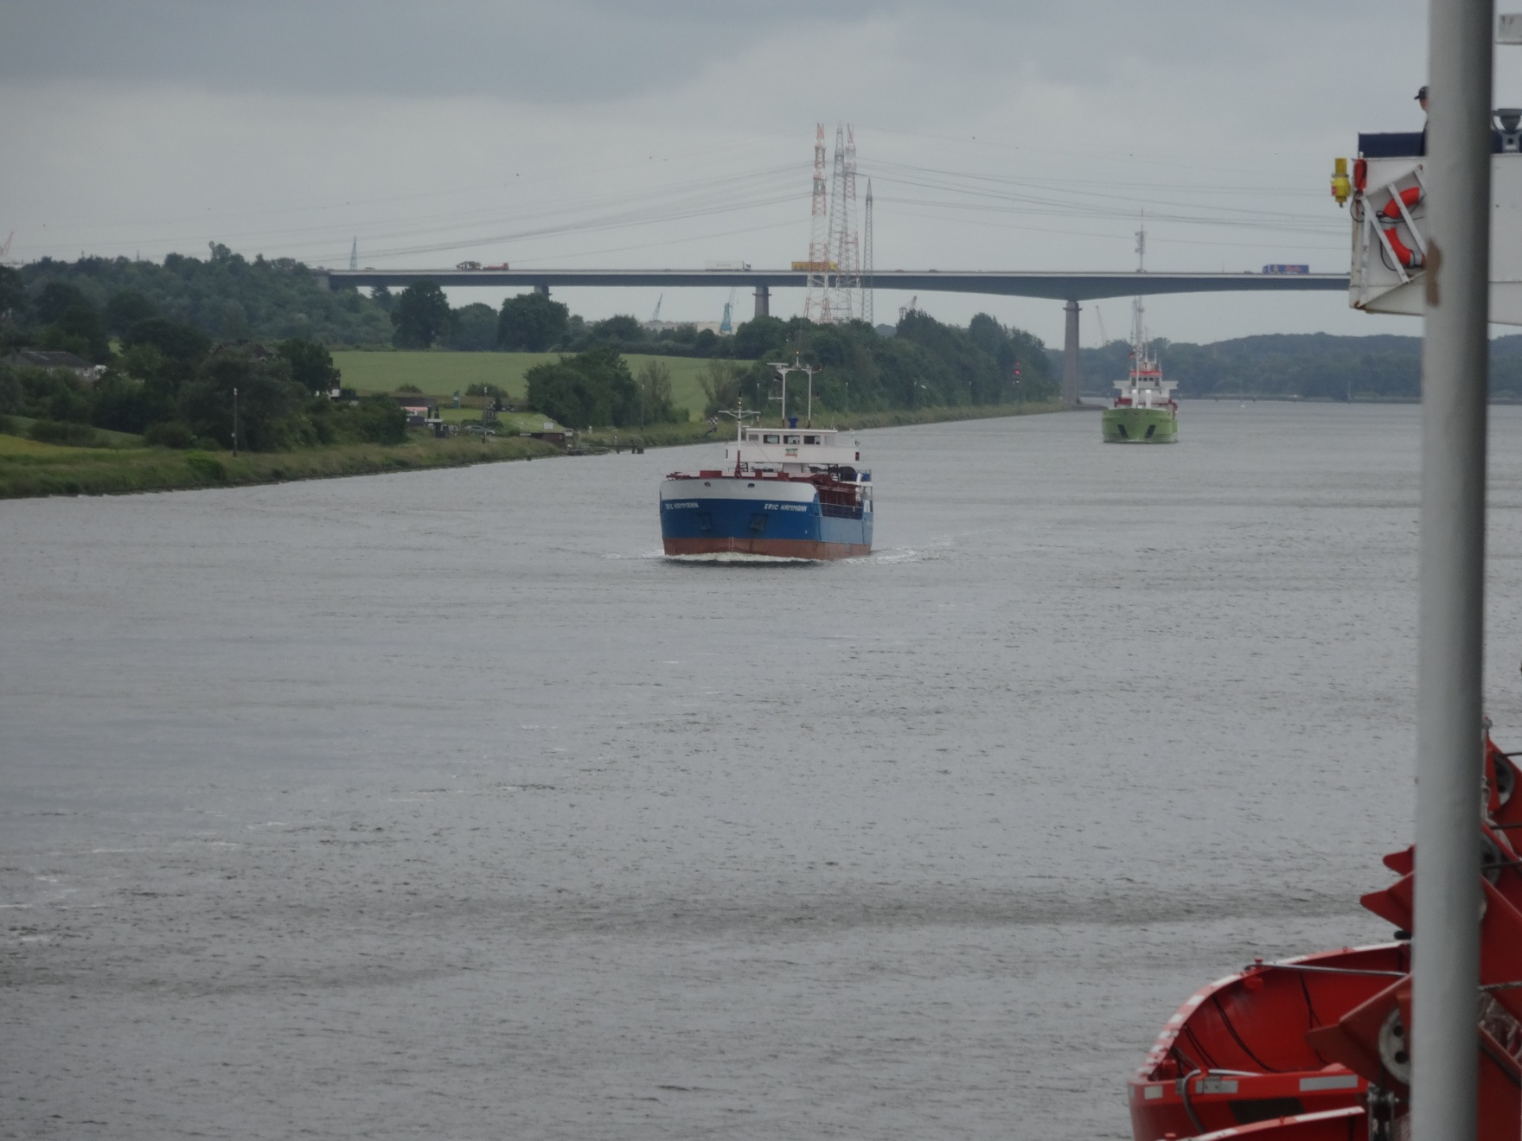
Cadet Survey Results

Slide 10
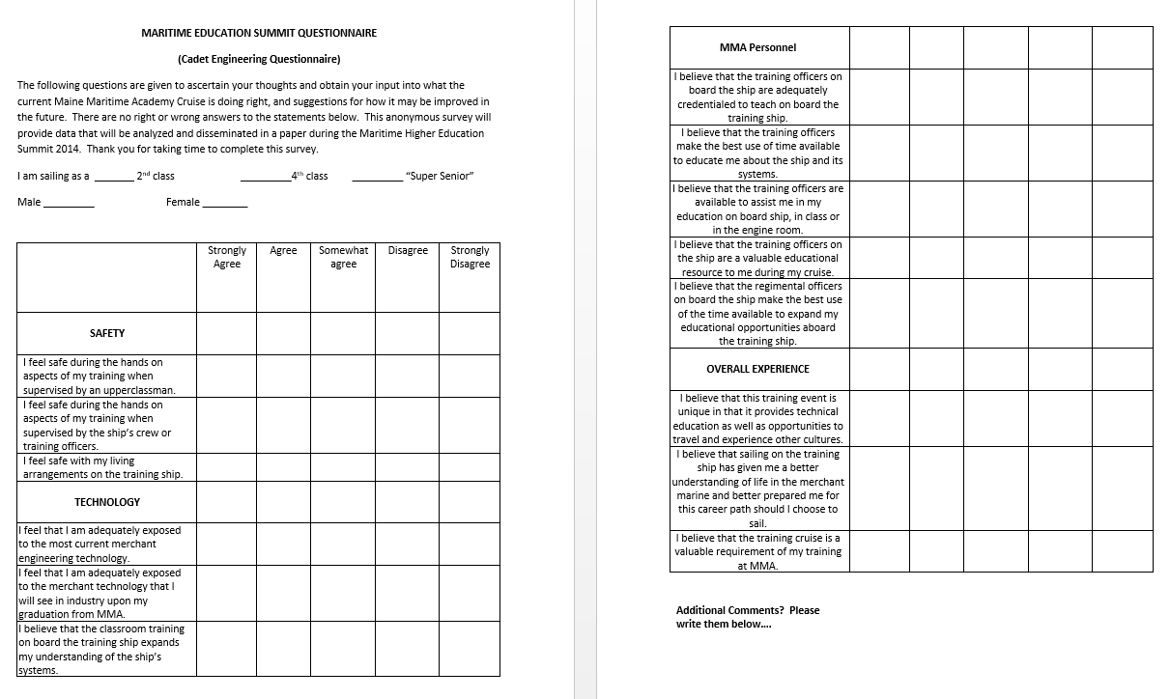
Cadet Survey Format

Slide 11
Cadet Survey Format
Cadets asked to identify if they were “Super Senior”, 2nd Class or 4th Class. In addition, they were asked if they were male or female.
Four main topics were assessed:
  Safety
  Technology
  MMA Personnel
  Overall Experience
The assessment used a scale of “Strongly Agree”, “Agree”, “Somewhat Agree”, “Disagree” or “Strongly Disagree” and were weighted 1, 2, 3, 4, 5 respectively. - Lower the number, better the ranking
At the end of the survey, cadets were encourage to add specific comments.

Slide 12
Cadet Survey - Safety
a. I feel safe during the hands on aspects of my training when supervised by an upperclassman.
Rank = 1.7
b. I feel safe during the hands on aspects of my training when supervised by the ship’s crew or training officers.
Rank = 1.3
c. I feel safe with my living arrangements on the training ship.
Rank = 1.7

Slide 13
Cadet Survey - Technology
a. I feel that I am adequately exposed to the most current merchant engineering technology.
Rank = 2.4
b. I feel that I am adequately exposed to the merchant technology that I will see in industry upon my graduation from MMA.
Rank = 2.3
I believe that the classroom training on board the training ship expands my understanding of the ship’s systems.
Rank = 1.8

Slide 14
Cadet Survey – MMA Personnel
a. I believe that the training officers on board the ship are adequately credentialed to teach on board the training ship.
Rank = 1.4
b. I believe that the training officers make the best use of time available to educate me about the ship and its systems.
Rank = 1.8
c. I believe that the training officers are available to assist me in my education on board ship, in class or in the engine room.
Rank = 1.4
d. I believe that the training officers on the ship are a valuable educational resource to me during my cruise.
Rank = 1.4
I believe that the regimental officers on board the ship make the best use of the time available to expand my educational opportunities aboard the training ship.
Rank = 3.2

Slide 15
Cadet Survey – Overall Experience
a. I believe that this training event is unique in that it provides technical education as well as opportunities to travel and experience other cultures.
Rank = 1.6
b. I believe that sailing on the training ship has given me a better understanding of life in the merchant marine and better prepared me for this career path should I choose to sail.
Rank = 1.8
I believe that the training cruise is a valuable requirement of my training at MMA.
Rank = 1.6

Slide 16
Cadet Survey Results
190 total surveys received
22 1st Class (“Super Seniors”) – no females
64 2nd Class (Juniors) – 4 females
104 4th Class (Freshmen) – 4 females

Slide 17
Cadet Survey Results - 1st Class
 | 1 | 2 | 3 | 4 | 5 | avg
Safety
a | 7 | 9 | 5 | 0 | 0 | 1.904
b | 10 | 12 | 0 | 0 | 0 | 1.545
c | 11 | 11 | 0 | 0 | 0 | 1.5
Technology
a | 2 | 6 | 11 | 2 | 0 | 2.619
b | 2 | 11 | 8 | 0 | 0 | 2.295
c | 7 | 12 | 3 | 0 | 0 | 1.818
Personnel
a | 10 | 12 | 0 | 0 | 0 | 1.545
b | 4 | 13 | 5 | 0 | 0 | 2.045
c | 11 | 10 | 1 | 0 | 0 | 1.545
d | 12 | 10 | 0 | 0 | 0 | 1.454
e | 0 | 3 | 3 | 3 | 12 | 4.113
Overall Exp
a | 8 | 8 | 4 | 2 | 0 | 2.000
b | 4 | 10 | 6 | 1 | 1 | 2.318
c | 7 | 10 | 4 | 1 | 0 | 1.954
No Females

Slide 18
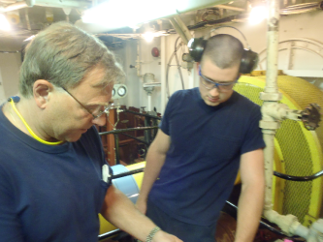
Cadet Survey Results
1st Class - Comments
“I believe the top students in the class are generally bored to tears.”
“We get really excellent instruction in small groups or one on one. Class is frequently review but one on one I get really valuable instruction.”
“I learn quite a bit on cruise, however I am also aware that the industry has a lot newer technology available that we aren't exposed to. Also I don't feel adequately trained for a steam plant.”

Slide 19
Cadet Survey Results
1st Class - Comments
“I believe the regimental staff frequently is the largest impediment to learning on this vessel. The show little vision or leadership and frequently get in the way of people who do. They also foster distrust and negatively effect student engagement in the program.”

Slide 20
Cadet Survey Results – 2nd Class
 | 1 | 2 | 3 | 4 | 5 | avg
Safety
a | 25 (1) | 27 (2) | 5 (1) | 1 | 0 | 1.689
b | 41 (3) | 20 (1) | 3 | 0 | 0 | 1.406
c | 37 (3) | 24 (1) | 3 | 0 | 0 | 1.468
Technology
a | 10 (1) | 25 (2) | 23 | 5 (1) | 1 | 2.406
b | 11 (1) | 30 (1) | 21 (1) | 2 (1) | 0 | 2.218
c | 26 (1) | 31 (3) | 6 | 0 | 0 | 1.695
Personnel
a | 44 (3) | 17 (1) | 1 | 0 | 0 | 1.306
b | 28 (2) | 29 (2) | 5 | 0 | 0 | 1.629
c | 42 (2) | 18 (2) | 2 | 0 | 0 | 1.354
d | 46 (3) | 15 (1) | 1 | 0 | 0 | 1.274
e | 12 (1) | 11 (1) | 13 (1) | 12 | 13 (1) | 3.049
Overall Exp
a | 31 (3) | 25 (1) | 6 | 0 | 0 | 1.596
b | 23 (2) | 19 (1) | 18 (1) | 2 | 0 | 1.983
c | 31 (3) | 22 | 7 (1) | 1 | 0 | 1.642
4 Females – Survey Results in ()

Slide 21
Cadet Survey Results
2nd Class - Comments
“Cadet shipping was a bit better as far as portraying life as a merchant mariner. I think junior cruise should be completed before cadet shipping.”
“Cadet Shipping offers a much more hands on realistic experience. Cadet Shipping twice would be more helpful.”
“Relatively speaking I feel as though I learned a greater volume of practical knowledge during cadet shipping.”
“Cadet shipping is more ideal. Less students to be focused on.”

Slide 22
Cadet Survey Results
2nd Class - Comments
“…I think too much time is spent in training learning the specifics of just this ship. I think that teaching concepts and expanding the idea of how the different systems function might be more beneficial. We spent a lot of time in both watch and maintenance learning about the specifics of this ship. Having a better idea of what we might see in the industry would be nice.”

Slide 23
Cadet Survey Results
2nd Class - Comments
“The regimental officers INTERFERE with my education because when I should be studying or doing something to learn my trade, I constantly feel like I could be getting kicked off cruise at the drop of a hat!”
“The regimental officers only make everyone paranoid. Almost like George Orwell's 1984…Big Brother. They make you feel like you're going to get in trouble for harmless tasks, and usually do. They do not need to be here.”

Slide 24
Cadet Survey Results
2nd Class - Comments
“Learn a lot in training, and a the teachers do a great job and have much to offer. The hands on aspect lacks just because its hard doing something with 100 kids and you can fix things that work. But I guess that’s what you learn in industry. Overall good cruise.”

Slide 25
Cadet Survey Results – 4th Class
 | 1 | 2 | 3 | 4 | 5 | avg
Safety
a | 52 (4) | 38 | 11 | 2 | 0 | 1.640
b | 78 (4) | 25 | 1 | 0 | 0 | 1.259
c | 50 (4) | 30 | 18 | 3 | 3 | 1.836
Technology
a | 20 (2) | 36 (2) | 39 | 7 | 2 | 2.375
b | 16 (1) | 51 (2) | 27 (1) | 6 | 4 | 2.336
c | 41 (2) | 40 (1) | 15 (1) | 6 | 2 | 1.923
Personnel
a | 59 (3) | 28 (1) | 6 | 0 | 0 | 1.430
b | 36 (3) | 39 (1) | 13 | 5 | 0 | 1.860
c | 56 (3) | 30 (1) | 6 | 1 | 0 | 1.483
d | 57 (3) | 33 (1) | 3 | 0 | 0 | 1.419
e | 13 (1) | 16 (1) | 33 (1) | 13 (1) | 18 | 3.075
Overall Exp
a | 53 (4) | 29 | 9 | 1 | 0 | 1.543
b | 51 (3) | 32 | 6 (1) | 2 | 1 | 1.586
c | 57 (2) | 26 (2) | 5 | 2 | 1 | 1.505
4 Females – Survey Results in ()

Slide 26
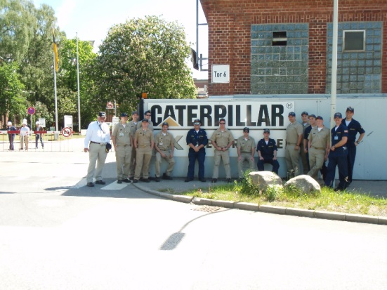
Cadet Survey Results
4th Class - Comments
“In port training opportunities should be available for all midshipmen, regardless of scheduler conflicts.”
“4th Class year is essentially "ship life lol". A LOT of time is wasted on idle, simple labor.”
“More hands on training for 4/c midshipmen.”

Slide 27
Cadet Survey Results
4th Class - Comments
“Engine Training staff have a hard time letting students learn. They often step in in order to demonstrate but do half the project for the student. I feel like something is being lost.”
“I think memorizing system drawings is a waste, we could learn much more important information in the hours we spend studying drawings only to forget them 10 mins. after the test.”

Slide 28
Cadet Survey Results
4th Class - Comments
“The amount of time wasted on this ship is ridiculous. Utilities is useful for the first hour maybe two, then they are purposefully wasting time. The lectures on drawings and the drawings in general are completely useless. Memorizing this has taught me nothing but how to be super stressed. Take me down and show me how this works and why, not that this valve is here and you need to remember that.”

Slide 29
Cadet Survey Results
4th Class - Comments
“I have had a much greater experience on cruise than I originally thought. I have learned so much, and am so grateful to be part of this experience. Thank you for your time & effort.”

Slide 30
Cadet Survey Results – All Classes
 | 1 | 2 | 3 | 4 | 5 | avg
Safety
a | 84 (5) | 74 (2) | 21 (1) | 3 | 0 | 1.687
b | 129 (7) | 74 (1) | 21 | 3 | 0 | 1.342
c | 98 (7) | 74 (1) | 21 | 3 | 0 | 1.674
Technology
a | 32 (3) | 67 (4) | 73 | 14 (1) | 3 | 2.413
b | 29 (2) | 92 (3) | 56 (2) | 8 (1) | 4 | 2.292
c | 74 (3) | 83 (4) | 24 (1) | 6 | 2 | 1.834
Personnel
a | 113 (6) | 57 (2) | 7 | 0 | 0 | 1.401
b | 68 (5) | 81 (3) | 23 | 5 | 0 | 1.802
c | 109 (6) | 58 (2) | 9 | 1 | 0 | 1.446
d | 115 (6) | 58 (2) | 4 | 0 | 0 | 1.373
e | 25 (2) | 30 (2) | 49 (2) | 28 (1) | 43 (1) | 3.196
Overall Exp
a | 92 (7) | 62 (1) | 19 | 3 | 0 | 1.619
b | 78 (5) | 61 (1) | 30 (2) | 5 | 2 | 1.818
c | 95 (5) | 58 (2) | 16 (1) | 4 | 1 | 1.614
8 Total Females – Survey Results in ()

Slide 31
Class Comparisons – Safety - a
I feel safe during the hands on aspects of my training when supervised by an upperclassman.
Remember…
Lower = better

Slide 32
Class Comparisons – Safety - b
I feel safe during the hands on aspects of my training when supervised by the ship’s crew or training officers.

Slide 33
Class Comparisons – Safety - c
I feel safe with my living arrangements on the training ship.

Slide 34
Class Comparisons – Technology - a
I feel that I am adequately exposed to the most current merchant engineering technology.

Slide 35
Class Comparisons – Technology - b
I feel that I am adequately exposed to the merchant technology that I will see in industry upon my graduation from MMA.

Slide 36
Class Comparisons – Technology - c
I believe that the classroom training on board the training ship expands my understanding of the ship’s systems.

Slide 37
Class Comparisons – Personnel - a
I believe that the training officers on board the ship are adequately credentialed to teach on board the training ship.

Slide 38
Class Comparisons – Personnel - b
I believe that the training officers make the best use of time available to educate me about the ship and its systems.

Slide 39
Class Comparisons – Personnel - c
I believe that the training officers are available to assist me in my education on board ship, in class or in the engine room.

Slide 40
Class Comparisons – Personnel - d
I believe that the training officers on the ship are a valuable educational resource to me during my cruise.

Slide 41
Class Comparisons – Personnel - e
I believe that the regimental officers on board the ship make the best use of the time available to expand my educational opportunities aboard the training ship.

Slide 42
Class Comparisons – Overall Exp - a
I believe that this training event is unique in that it provides technical education as well as opportunities to travel and experience other cultures.

Slide 43
Class Comparisons – Overall Exp - b
I believe that sailing on the training ship has given me a better understanding of life in the merchant marine and better prepared me for this career path should I choose to sail.

Slide 44
Class Comparisons – Overall Exp - c
I believe that the training cruise is a valuable requirement of my training at MMA.

Slide 45
Cadet Survey Results
All Classes – Take Away Comments
“Super Seniors” because of the need to go on Cruise after they have graduated tend to be more critical of the program as a whole and especially the Regimental aspects.
The 2nd Class, acting primarily as supervision and operators, have a higher regard for the training they are receiving but also tend to compare to the uniqueness of Cadet Shipping.
The 4th Class, acting primarily as engine round, maintenance and utility personnel, have a higher disregard for what they perceive is “time wasters”

Slide 46
Cadet Survey Results
All Classes – Take Away Comments
Review towards minimizing/elimination of training on ship specific systems
Refine classroom/engineroom class sizes
Incorporate present day technology/relation to ship systems
Review of Regimental - Shipboard life aspects
Expand Port of Call industry visits

Slide 47
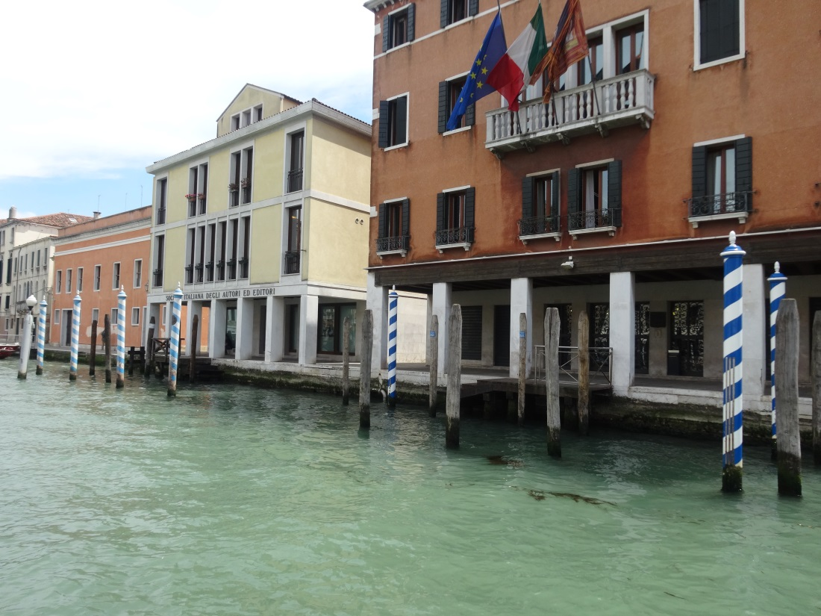
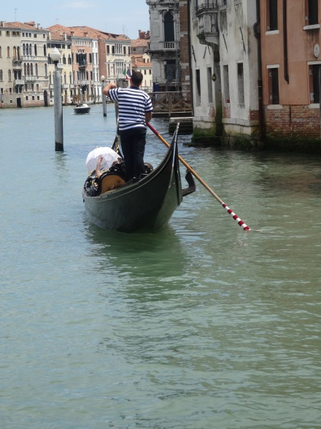

Engineering Training Officer Survey Results

Slide 48
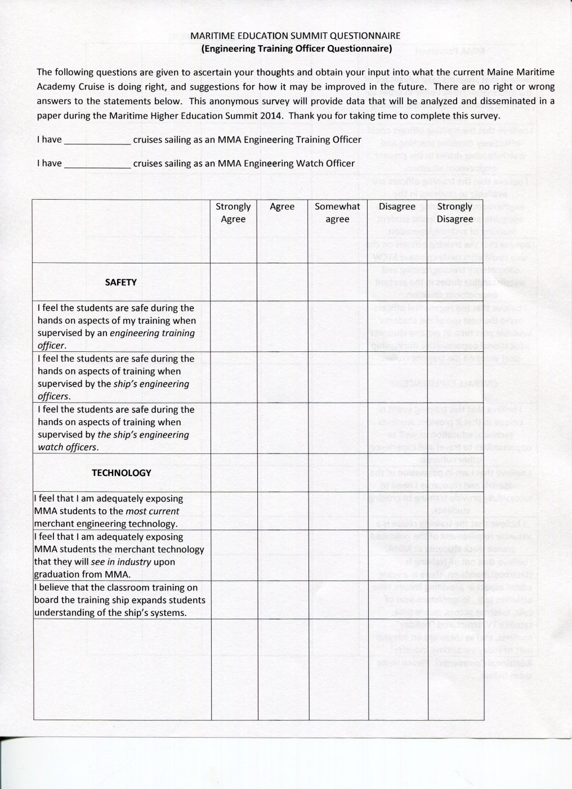
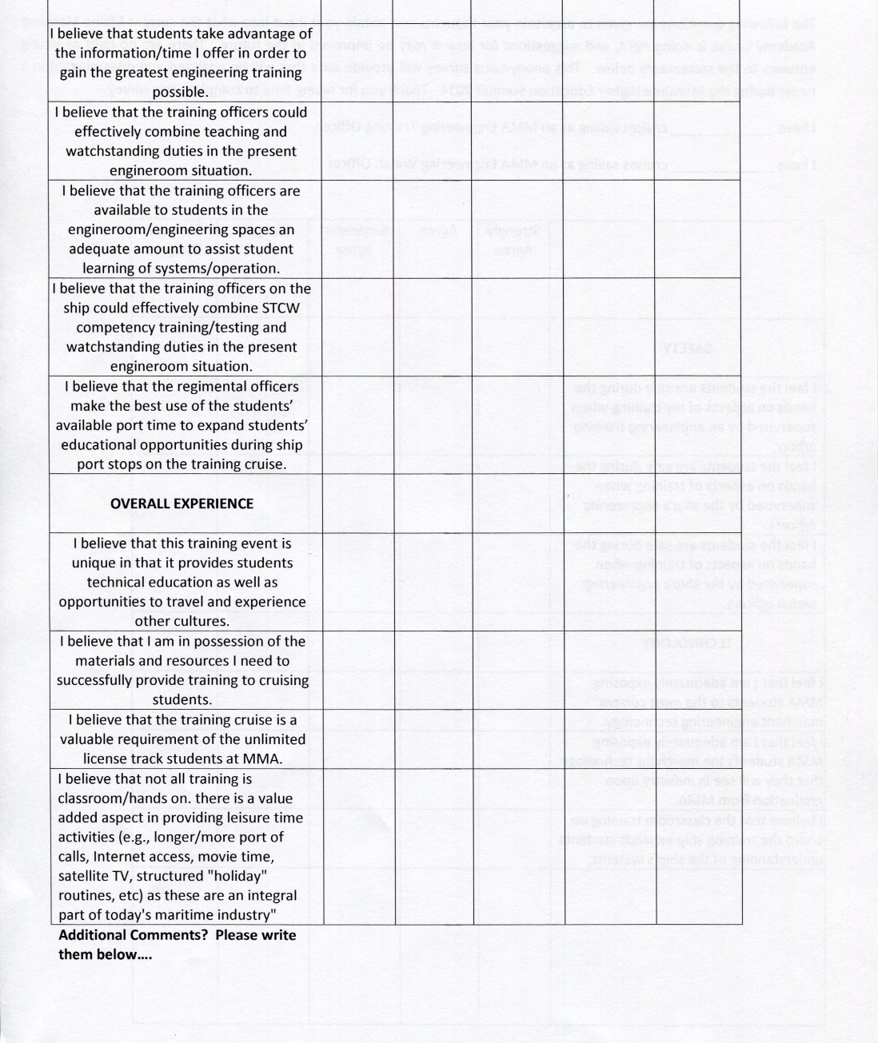
Training Officer Survey Format

Slide 49
Survey Summary
strongly agree = | 1
agree = | 2
somewhat agree = | 3
disagree = | 4
strongly disagree = | 5
Numbers of years as training officer | 2,2,1,17,6,12,13,18
 | 1 | 2 | 3 | 4 | 5 | avg
Safety
a | 7 |  | 1 |  |  | 1.4
b | 7 |  |  | 1 |  | 1.6
c | 6 |  | 1 |  |  | 1.5
Technology
a |  | 2 | 4 | 1 | 1 | 3.6
b | 1 | 5 | 1 | 2 |  | 3.1
c | 6 |  | 1 |  |  | 1.5
personnel
a | 1 | 1 | 4 | 2 |  | 3.3
b | 1 |  | 1 | 1 | 5 | 4.7
c | 4 | 2 | 1 |  |  | 1.8
d | 1 | 1 | 1 | 2 | 3 | 4.1
e |  | 1 | 2 | 3 | 2 | 4.3
Overall Exp
a | 7 | 1 |  |  |  | 1.3
b | 2 | 3 | 2 |  | 1 | 2.7
c | 7 | 1 |  |  |  | 1.3
d | 4 | 3 | 1 |  |  | 1.9

Slide 50
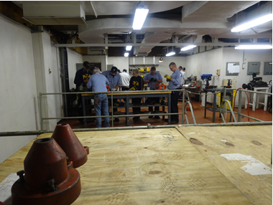
Safety
I feel the students are safe during the hands on aspects of my training when supervised by an engineering training officer.
Rank = 1.4
I feel the students are safe during the hands on aspects of training when supervised by the ship’s engineering officers.
Rank = 1.6
I feel the students are safe during the hands on aspects of training when supervised by the ship’s engineering watch officers.
Rank = 1.5
Therefore it is apparent that the training officer’s impression of student safety on the ship is good, landing squarely between “strongly agree” and “agree”.

Slide 51
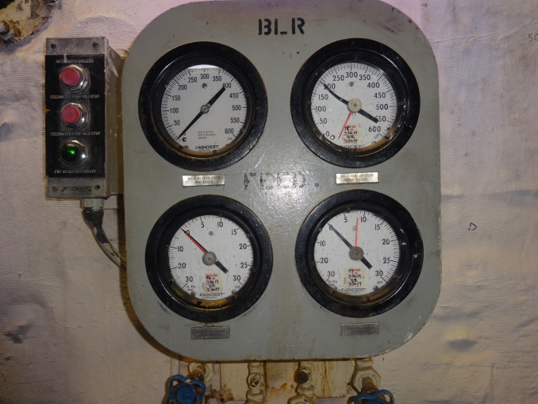
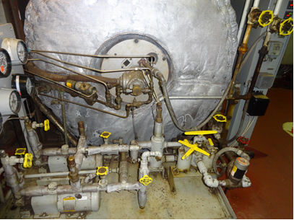
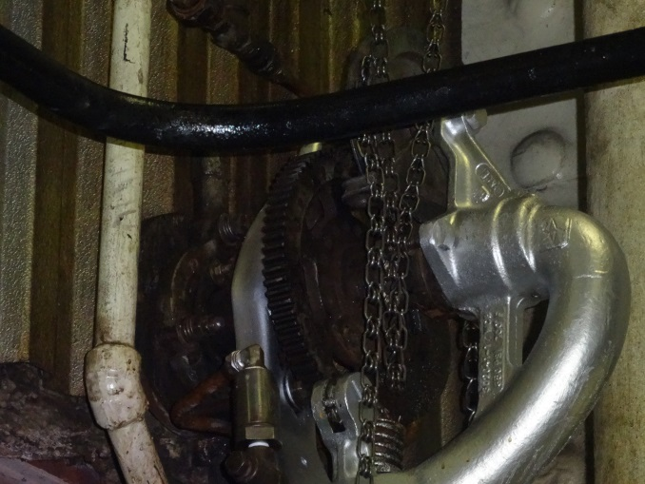
Technology
I feel that I am adequately exposing MMA students to the most current merchant engineering technology.
Rank = 3.6
I feel that I am adequately exposing MMA students to the merchant technology that they will see in industry upon graduation from MMA.
Rank = 3.1
I believe that the classroom training on board the training ship expands students understanding of the ship’s systems.
Rank = 1.5

Slide 52
Technology Comments
The impression of the training officers is that while the ship provides an excellent training opportunity not available to many college students, our own training ship does not provide students with adequate exposure to all the most current engineering technology
Ranking between “somewhat agree” and “disagree”, nor to the equipment that they may see upon graduation from MMA – also ranking between “somewhat agree” and “disagree”.
The training officers do believe that the classroom training addressing the specific equipment and operations of said equipment on board the training ship does expand students’ understanding of this equipment.

Slide 54
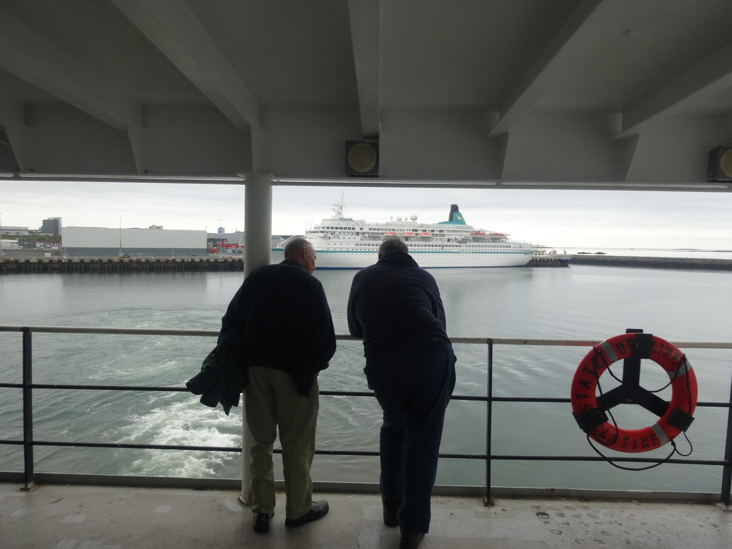
MMA Personnel

Slide 55
MMA Personnel
I believe that the students take advantage of the information/time I offer in order to gain the greatest engineering training possible.
Rank = 3.3
I believe that the training officers could effectively combine teaching and watchstanding duties in the present engineroom situation.
Rank = 4.7
I believe that the training officers are available to students in the engineroom/engineering spaces an adequate amount of time to assist student learning of systems/operation.
Rank = 1.8
I believe that the training officers on the ship could effectively combine STCW competency training/testing and watchstanding duties in the present engineroom situation.
Rank = 4.1
I believe that the regimental officers make the best use of the students’ available port time to expand students’ educational opportunities during ship port stops on the training cruise.
Rank = 4.3

Slide 56
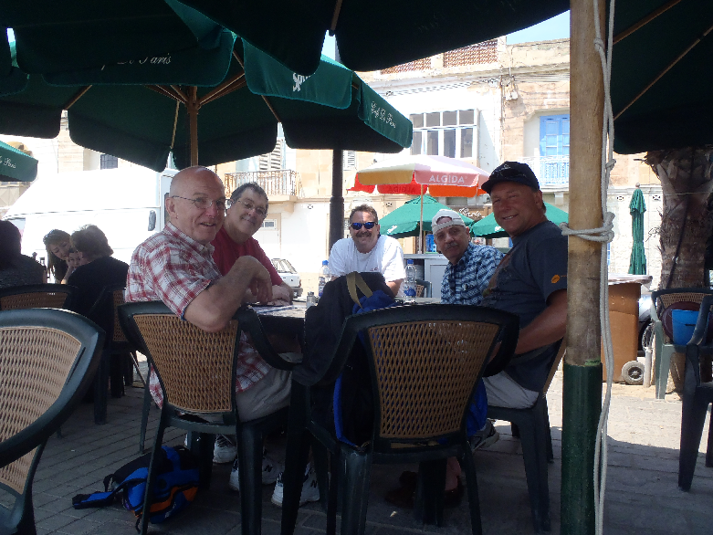

Slide 57
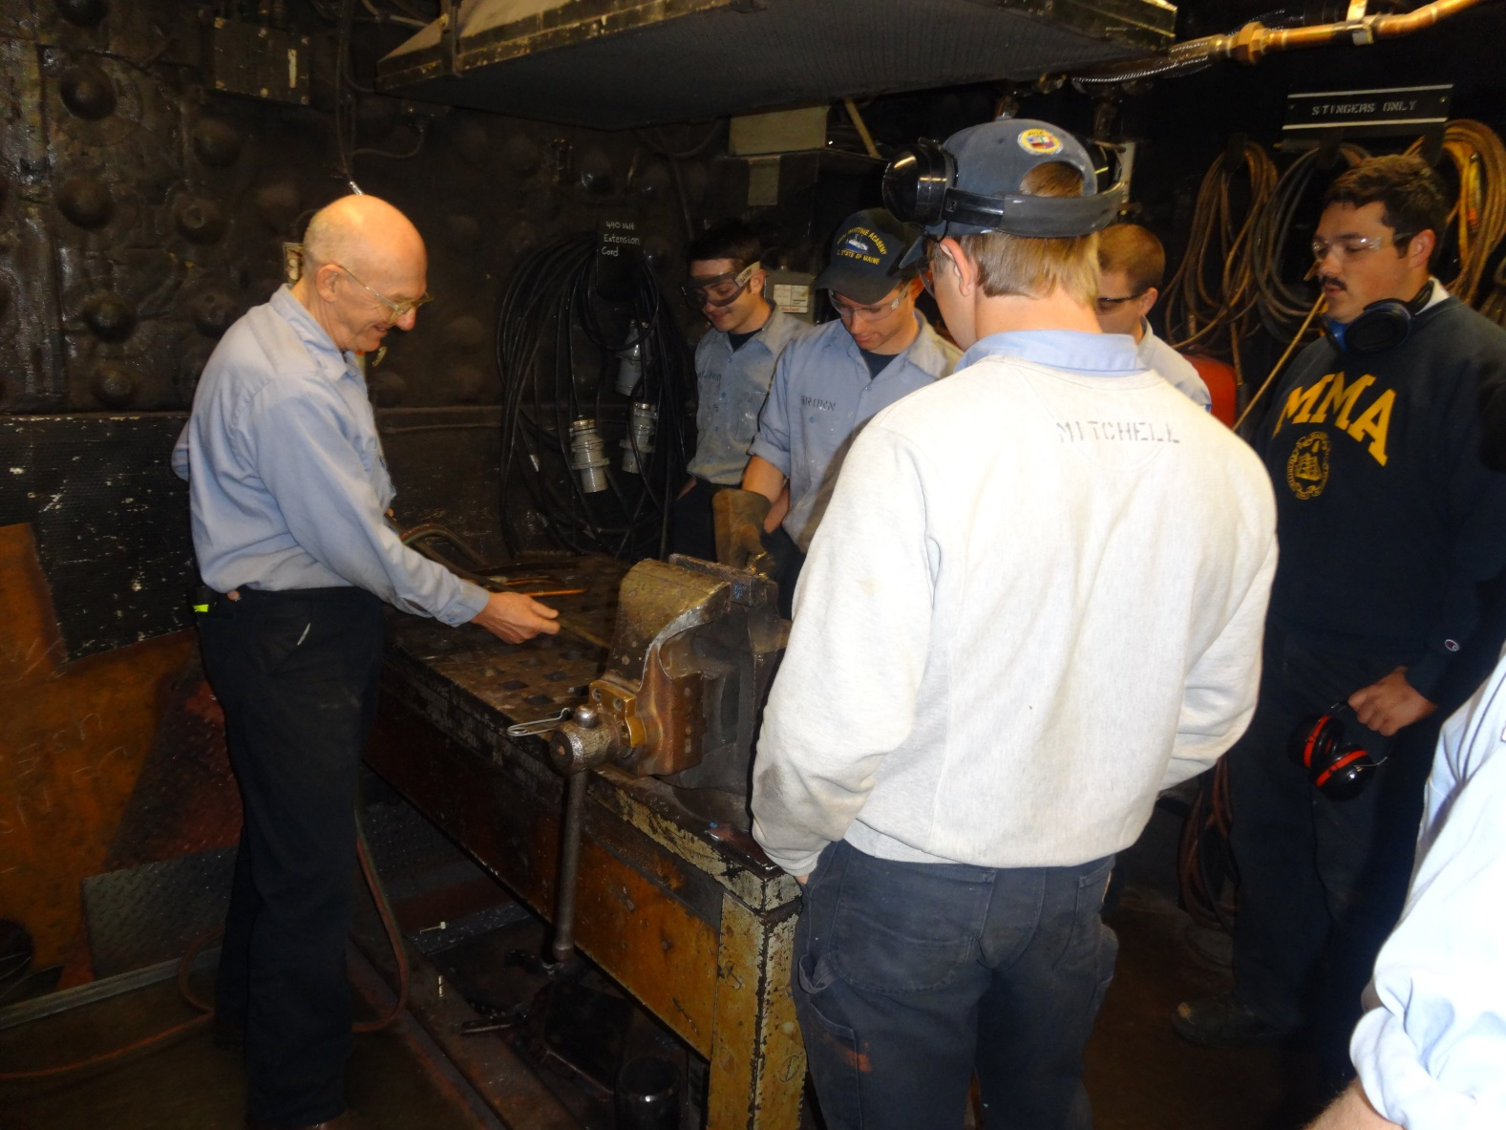
Hands On Training

Slide 58
This category investigates the trainers’ views of the cadets efforts, as well as the trainers’ views on training in the current training ship engine spaces.
The trainers “strongly agree/agree” that this provides an adequate amount of contact time with the students in the engine spaces. Cadets are encouraged to come to the engineering spaces for additional training or informal instruction.
The trainers “somewhat agree” that the cadets take advantage of the time offered to do this, though attendance during the beginning of the cruise is typically light, and picks up significantly during the final weeks of cruise.

Slide 59
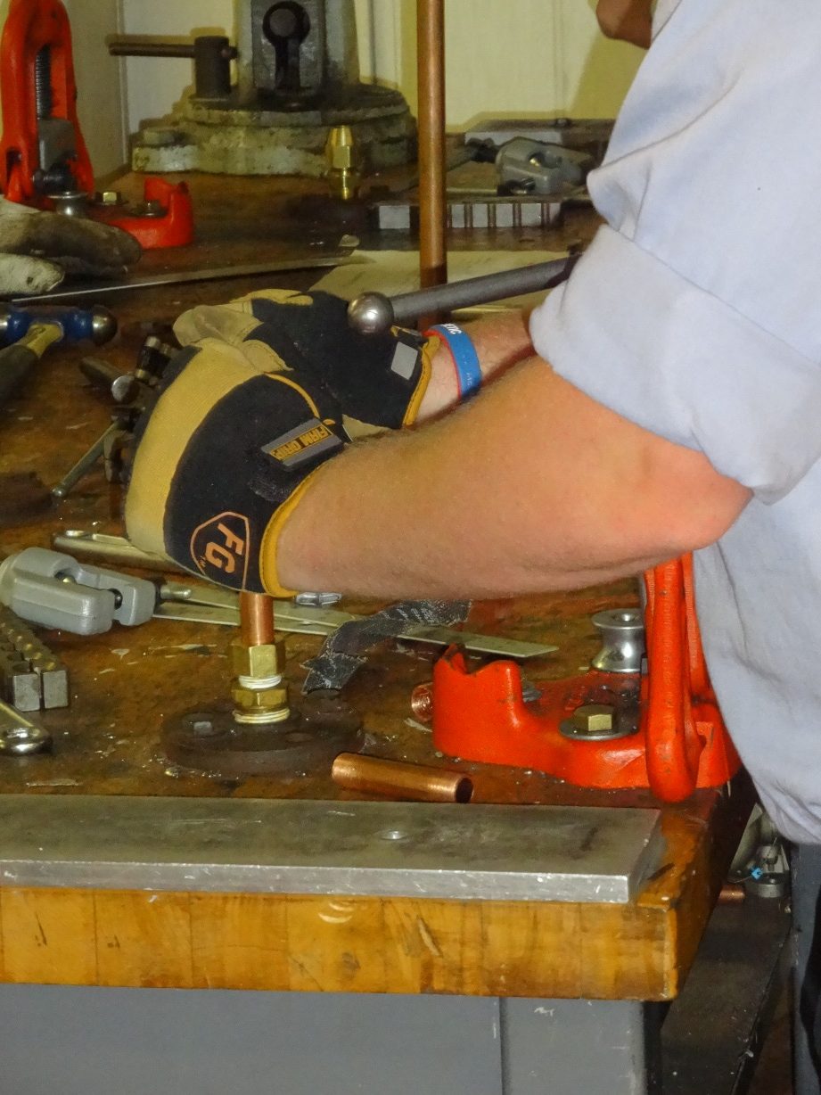
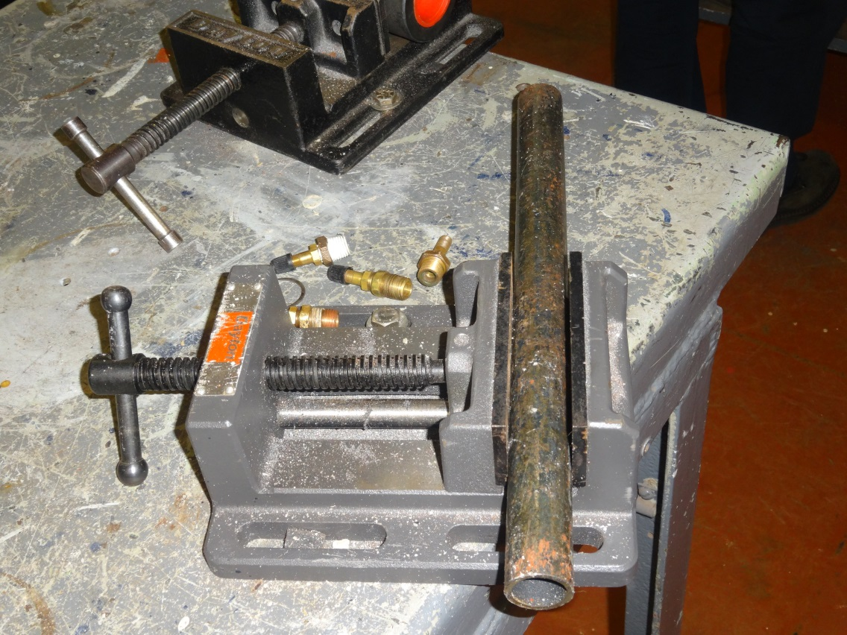
Freshman Cadet Training

Slide 60
Training officers “disagree/strongly disagree” that effective lecturing/large group instruction could happen on watch. Firstly, watch is a designated job in itself and attention from watchstanding tasks should not be taken for non watchstanding activities. This is not to say that watch engineers do not instruct cadets, but their instruction is to cadets that are also on watch, not in a training rotation.
Watchstanding cadets shadowing watchstanding officers reinforces proper watchstanding techniques and responsibilities.
For similar reasons training officers “disagree/strongly disagree” that cadet STCW competency training/testing should be combined with watchstanding duties. The importance of proper watchstanding can not be passed to the students if the watch engineers are multi-tasking and having their attention taken away from their primary tasks.

Slide 62
Overall Experience
I believe that this training event is unique in that it provides students technical education as well as opportunities to travel and experience other cultures.
Rank = 1.3
I believe that I am in possession of the materials and resources I need to successfully provide training to cruising students.
Rank = 2.7
I believe that the training cruise is a valuable requirement of the unlimited license track students at MMA.
Rank = 1.3
I believe that not all training is classroom/hands on. There is a value added aspect in providing leisure time activities as these are an integral part of today’s maritime industry.
Rank = 1.9

Slide 63

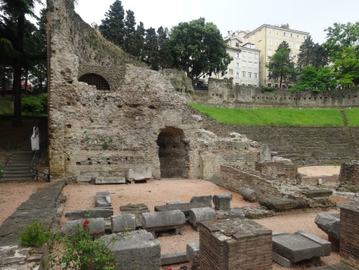
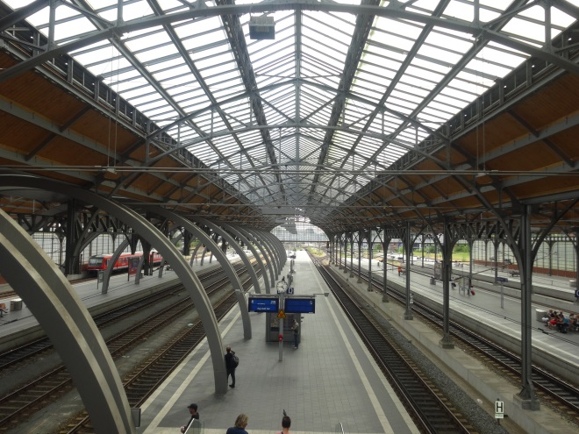

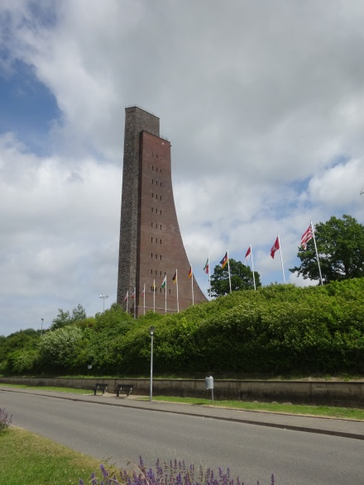
Cadet Exposure to the World

Slide 64
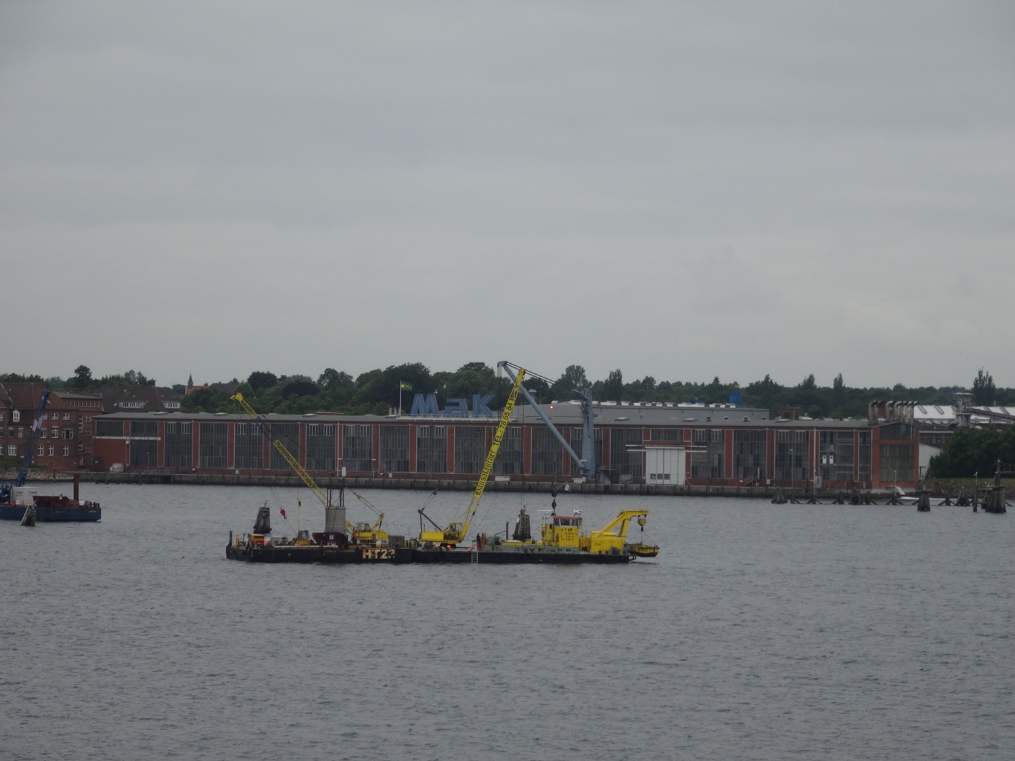
MAK Factory Tour Kiel, Germany

Slide 65
The training officers “Strongly agree/agree” that this is a unique event that is a valuable requirement of the unlimited license track students that provides special opportunities that many college students do not experience.
They also “strongly agree/agree” that providing leisure time activities and more/longer port calls can add value to the cadet sailing experience.
They only “agree/somewhat agree” that they are in possession of the materials and resources needed for effective training (e.g., current technologies, including Internet for follow-on research of topics to enforce student understanding)

Slide 66
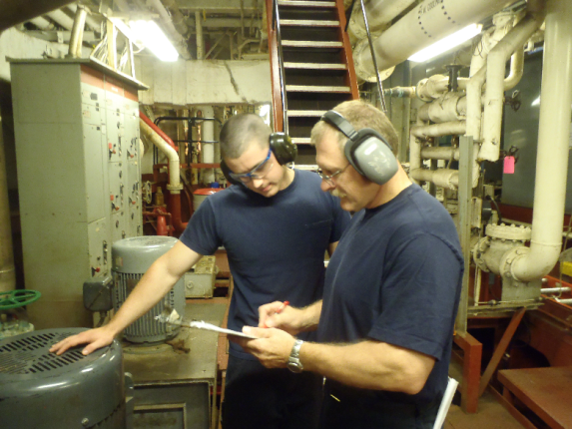
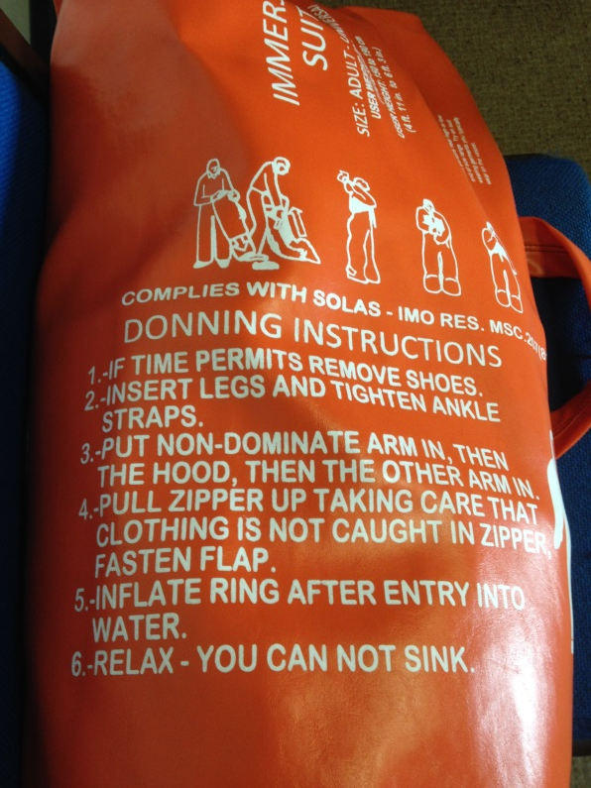
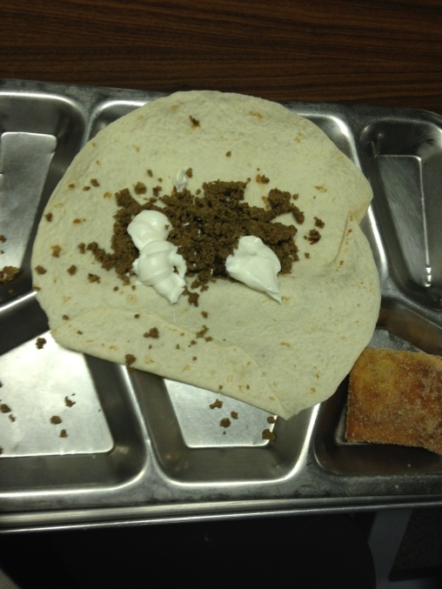

Good Weather, Good Food, Good Lifesaving Drills….

Slide 67
Possible Future Areas of Training
Opportunities for growth in areas such as
  High Voltage Electrical Safety
  Hydraulics
  Preventative Maintenance Systems
  Engine Room Management

Slide 68
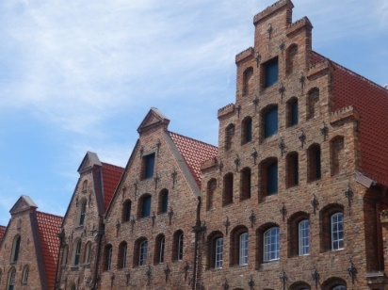
New Course Format
The change to the sailing schedule will demand more staff. If a training officer sails all 90 days with the current academic year there is very little time off at the end of the spring semester, nor prior to the fall semester. If the training officer only sails 45 days there must be another training officer recruited for the next leg of the cruise. And despite the changing out of training officers on different cruise legs there must be continuity of training for the students.
If faculty and staff at MMA are not numerous enough to staff all training positions others must be brought in from industry. At this point MMA must be careful that those joining the ship have some awareness of working with students in such an environment.
Other things to consider…
  Requirement of some staff/faculty to cruise?
  Pay scales for those cruising
  Relief from academic year teaching obligations if a full 90 days is sailed
  Consideration for improved “Hotel” services (e.g., satellite TV, Phone, Internet, etc) to the current standard of the industry.

Slide 69




