Slide 1
Maritime Education Factors and Presenteeism: A Comparative Quantitative Study
Virginia (Vicki) Ferritto, Ph.D.
Assistant Professor, SUNY Maritime College
`
Maritime Education Summit (MES) 2014
October 18, 2014

Slide 2
Presenteeism
Not Absent (1950s)
Present but unwell – Measurement related to health issues (1970s)
Student perceived academic performance loss – Measurement related to health issues (2005; 2009; 2011, 2013)
Student perceived academic performance loss – Measurement related to academic success behaviors (this study)

Slide 3
Problem
Gaps in extant maritime education and presenteeism literature:
Presenteeism extended to students’ perceived academic performance
Maritime education-related factors’ association with presenteeism
Measure presenteeism using academic achievement-related elements instead of health issues

Slide 4
Research Questions
Overarching research question: What is the difference in the level of presenteeism between license students who do and do not report distinct maritime education factors as having either a favorable or negative impact on their perceived academic performance?
Favorable Factors
ResQ 1: Cruise
ResQ 2: License/Maritime Instruction
Negative Factors
ResQ 3: Mandatory Regimental Activities
ResQ 4: Taps
ResQ 5: Morning or Afternoon Formations
ResQ 6: Watch

Slide 5
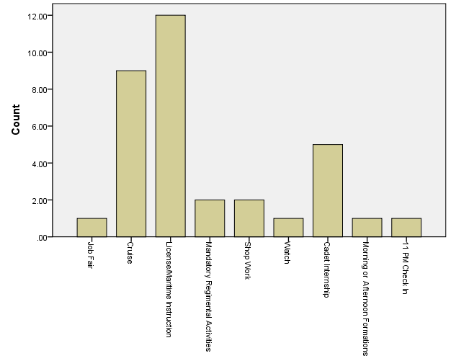
Reported Favorable Factors

Slide 6
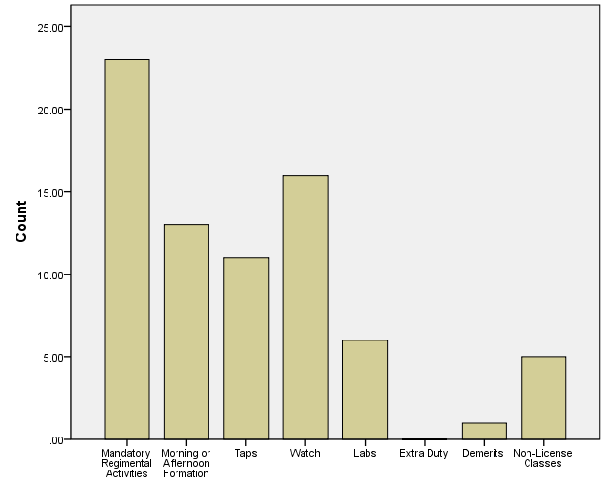
Reported Negative Factors

Slide 7
Methodology
Comparative quantitative research design
Cross-sectional
Non-experimental
Paper-pencil survey
Likert-type and open-ended questions
SPSS for Windows (IBM SPSS 19.0 Professional, SPSS Inc., Chicago, IL)
All analyses were two-sided with 5% alpha level
Hypotheses tested with two-sample t-tests

Slide 8
Construct and Instrument
Construct
Presenteeism was operationalized as a construct to represent the abstract concept of students’ perceived academic performance
Instrument
Presenteeism and Perceived Academic Performance (PPAP) Scale*
Excellent internal consistency reliability
High Cronbach’s alpha score: .90
Inter-Item Correlations: Ranged from .55 to .79
Corrected Item-Total Correlations: Ranged from .69 to .83
*Developed by the researcher (Ferritto) for this study

Slide 9
Population
Purposive sampling technique
Study’s Sample (N = 54)
Supported with power analysis
Filtered from 73 respondents
Gender: 12 (22%) female; 42 (78%) male
Class
3/C - 16 (30%)
2/C - 18 (33%)
1/C - 20 (37%)
Program:
47 (87%) - Marine Transportation Deck License
6 (11%) - Marine Engineering License
1 (0.2%) - Naval Architecture License

Slide 10
Summary of Results
The null hypotheses were not rejected
No statistical evidence to suggest the level of presenteeism among the study’s sample of license students is associated with factors they perceived to favorably or negatively impact academic performance.
Additional insight from two open-ended questions
Imbalance between time students can allocate to academics and time allocated to meet regimental requirements and responsibilities
Lack of sleep opportunities

Slide 11
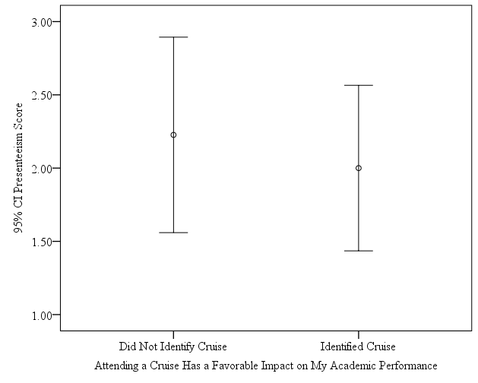
Hypothesis 1
Null (H₀1): There is no difference in the average presenteeism score between license students who did and did not identify cruise as favorably impacting their academic performance.
T-test yielded no statistically significant difference in the average presenteeism score between the two groups.
t(22) = .51; p = .62; therefore, the null hypothesis was not rejected

Slide 12
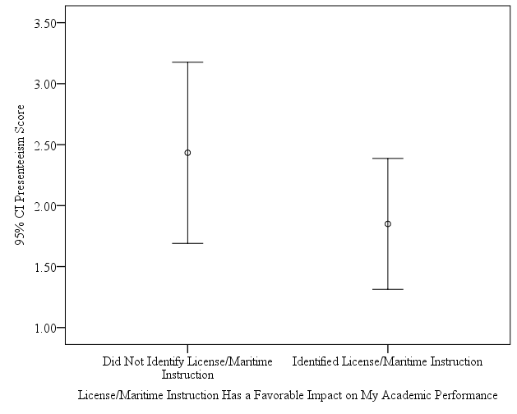
Hypothesis 2
Null (H₀2): There is no difference in the average presenteeism score between license students who did and did not identify license/maritime instruction as favorably impacting their academic performance.
T-test yielded no statistically significant difference in the average presenteeism score between the two groups.
t(22) = 1.40; p = .18; therefore, the null hypothesis was not rejected

Slide 13
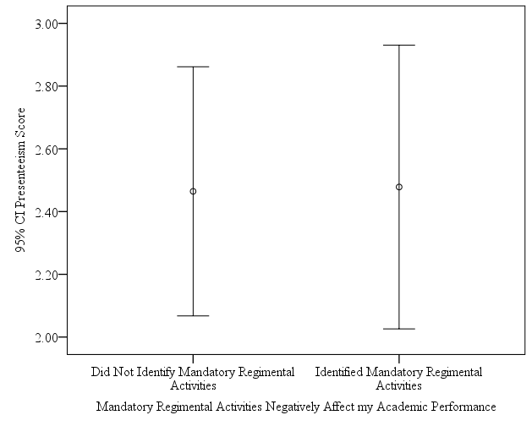
Hypothesis 3
Null (H₀3): There is no difference in the average presenteeism score between license students who did and did not identify mandatory regimental activities as negatively impacting their academic performance.
T-test yielded no statistically significant difference in the average presenteeism score between the two groups.
t(52) = -.05; p = .96; therefore, the null hypothesis was not rejected

Slide 14
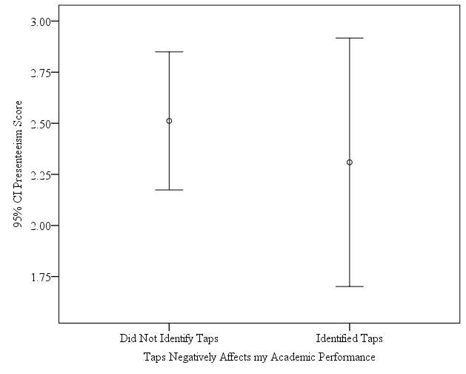
Hypothesis 4
Null (H₀4): There is no difference in the average presenteeism score between license students who did and did not identify taps as negatively impacting their academic performance.
T-test yielded no statistically significant difference in the average presenteeism score between the two groups.
t(52) = .56; p = .58; therefore, the null hypothesis was not rejected

Slide 15
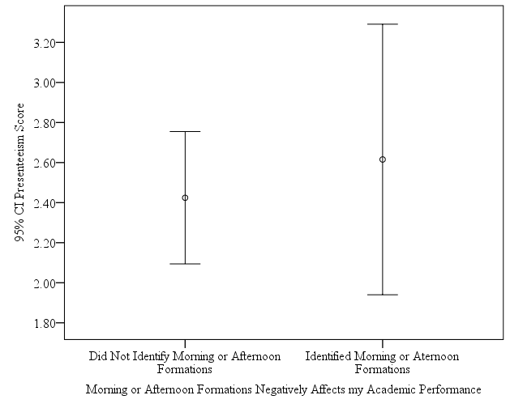
Hypothesis 5
Null (H₀5): There is no difference in the average presenteeism score between license students who did and did not identify morning or afternoon formations as negatively impacting their academic performance.
T-test yielded no statistically significant difference in the average presenteeism score between the two groups.
t(52) = -.56; p = .58; therefore, the null hypothesis was not rejected

Slide 16
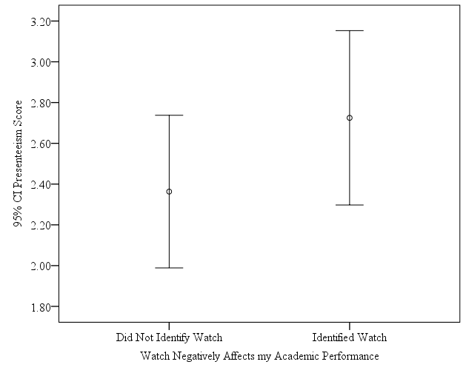
Hypothesis 6
Null (H₀6): There is no difference in the average presenteeism score between license students who did and did not identify watch as negatively impacting their academic performance.
T-test yielded no statistically significant difference in the average presenteeism score between the two groups.
t(52) = -1.15; p = .25; therefore, the null hypothesis was not rejected

Slide 17
Significance of the Study
Filled gaps in presenteeism and maritime education literature
First to investigate presenteeism among license students
First to operationalize presenteeism using student behaviors associated with academic performance
May add insight to support discussions with license students
May be of interest to maritime education administrators, policy makers, and educators

Slide 18
Limitations
Study sample
Accuracy of self-reported data
Recall bias
Initial use of PPAP Scale
Favorable and negative factor identification

Slide 19
Recommendations for Future Research
Other license student populations
General student populations
Demographic variables (e.g., age, gender, class, major, GPA)
Investigate other respondent identified favorable and negative factors
Offer respondents list of negative and favorable factors
Compare PPAP Scale results to objective measures
Longitudinal studies
Complement studies using health-related issues to operationalize presenteeism among students

Slide 20
References
Deroma, V. M., Leach, J. B., & Leverett, J. P. (2009). The relationship between depression and college academic performance. College Student Journal, 43(2), 325-334.
Hysenbegasi, A., Hass, S. L., & Rowland, C. R. (2005). The impact of depression on the academic productivity of university students. Journal of Mental Health Policy and Economics, 8(3), 145-151.
Matsushita, M., Adachi, H., Arakida, M., Namura, I., Takahashi, Y., Miyata, M., . . . Sugita, Y. (2011). Presenteeism in college students: Reliability and validity of the presenteeism scale for students. Quality of Life Research, 20(3), 439-446. doi:10.1007/s11136-010-9763-9
Mikami, A., Matsushita, M., Adachi, H., Suganuma, N., Koyama, A., Ichimi, N., . . . Sugita, Y. (2013). Sense of coherence, health problems, and presenteeism in Japanese university students. Asian Journal of Psychiatry, 6(5), 369-372. doi:10.1016/j.ajp.2013.03.008

Slide 21
Thank you for your attention!
Questions?
Comments?
Virginia (Vicki) Ferritto, Ph.D.
Assistant Professor, SUNY Maritime College
Email: VickiF631@aol.com or vferritto@sunymaritime.edu
Office: 718-409-4181
Cell: 201-650-2638

