Slide 1
Maritime Education Summit
Teaching Physics at a Maritime Academy
David P. Ciampa, Ph.D.
Maine Maritime Academy

Slide 2
Teaching Physics at a Maritime Academy David P. Ciampa, Ph.D.
Maritime academy vs standard institution
At the academy:
Regimented lifestyle
Emphasis on “hands-on” training
Student mind-set tends to be more practical
Shorter semesters

Slide 3
Teaching Physics at a Maritime Academy David P. Ciampa, Ph.D.
Key to understanding physics and succeeding in the course:
Solve physics problems—lots of them!!
Difficult to sell this concept to students
“I have no difficulty understanding the ideas; I just can’t solve the problems.”

Slide 4
Teaching Physics at a Maritime Academy David P. Ciampa, Ph.D.
How to motivate students to do assigned problems?
Grading homework is not an effective motivator
Quizzes:
One homework problem from those assigned

Slide 5
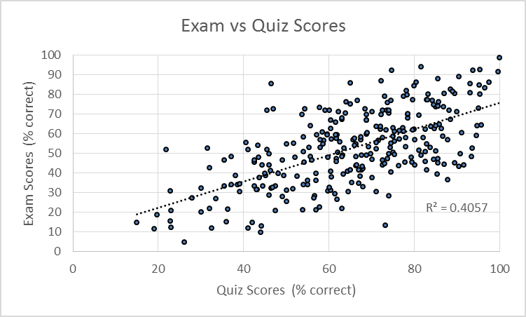
Teaching Physics at a Maritime Academy David P. Ciampa, Ph.D.
Quiz scores and exam scores show a correlation

Slide 6
Teaching Physics at a Maritime Academy David P. Ciampa, Ph.D.
Problem solving is a challenging art-form to master
difficulties include:
Lack of preparation in algebra
Distinguishing between the physics and the algebra
Translating from language to mathematical formulism
The idea that we use a few basic equations and principles to solve a wide variety of problems
Using dimensional analysis as a diagnostic
Using a linear approach to the solution
Telescoping between the overall flow and the details

Slide 7
Teaching Physics at a Maritime Academy David P. Ciampa, Ph.D.
Problem # 25 (Chapter 21, Physics, Walker, 4th ed, Addison-Wesley)
Two light-bulbs operate on the same potential difference. Bulb A has four times the power output of bulb B. (a.) Which bulb has the greater current passing through it? Explain. (b.) What is the ratio of the current in bulb A to the current in bulb B?

Slide 8
Teaching Physics at a Maritime Academy David P. Ciampa, Ph.D.
Problem: (#17 Ch.4, Physics, by Walker, 4th ed, Addison-Wesley)
A mountain climber jumps a 2.8-m-wide crevasse by leaping horizontally with a speed of 7.8m/s. (a.) If the climber’s direction of motion on landing is -45º, what is the height difference between the two sides of the crevasse? (b.) Where does the climber land?

Slide 9
Teaching Physics at a Maritime Academy David P. Ciampa, Ph.D.
Some techniques I have tried:
Digital pen technology
Effective for those who use it
Cooperative grouping (sets of three students)
Not effective as implemented
Discussion-oriented presentation in class
Limited effectiveness
Conceptual post- and pre-tests
Helpful as a diagnostic

Slide 10
Teaching Physics at a Maritime Academy David P. Ciampa, Ph.D.
Flipped classroom:
On-line lectures and problem-solving during class
An interesting idea if the students are motivated
A hybrid approach between traditional and flipped:
5-7 minutes of lecture followed by problem-solving; repeat
Students solve problems during class
I sample students’ work while they solve problems, allowing me to address the particular issues I observe

Slide 11
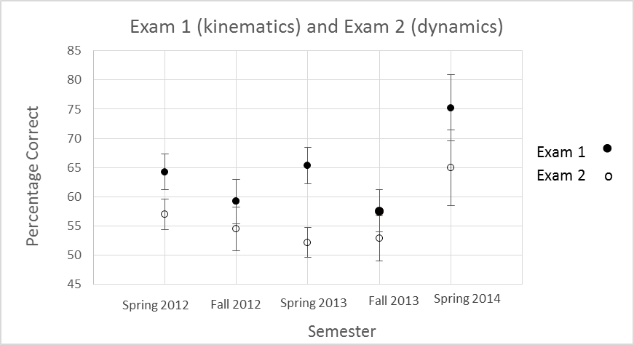
Teaching Physics at a Maritime Academy David P. Ciampa, Ph.D.
Results of hybrid method (Spring 2014 data) compared with other semesters

Slide 12
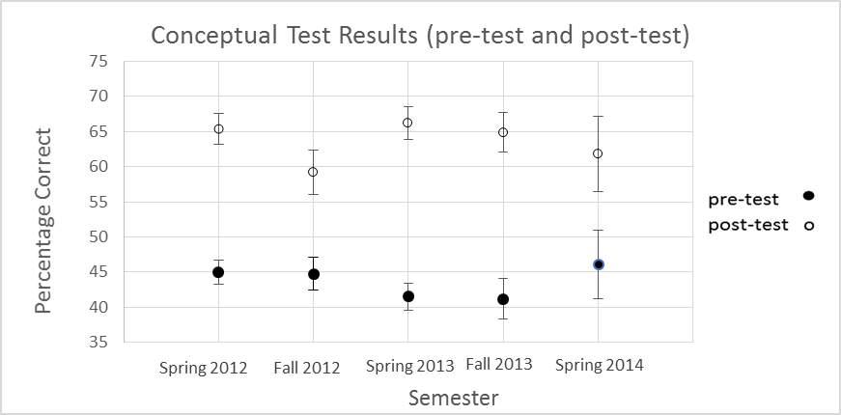
Teaching Physics at a Maritime Academy David P. Ciampa, Ph.D.
Spring 2014 students were neither more prepared nor did they perform better
on the conceptual test than students from other semesters

