Slide 1
WOMEN in the MARITIME INDUSTRY: Recruitment and retention
IDENTIFYING ATTITUDINAL AND STRUCTURAL IMPEDIMENTS
Ana M. Albert Dr. Joan Mileski Dr. Wyndylyn Von Zharen
MBA Candidate Head, Regents Professor
International Business Department of Maritime Administration Department of Maritime Sciences
Professor
ANA M. ALBERT

Slide 2
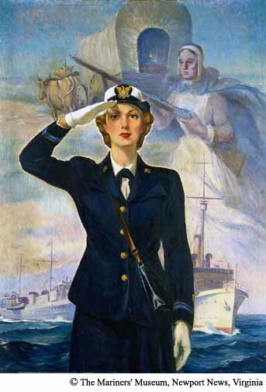
agenda
Introduction
WARS Characteristics
Wealth
Appreciation
Risk & Negative Consequences
Sacrifice
Methodology & Study Design
Results
Conclusion
Q&A

Slide 3
Introduction

Slide 4
Women more entrenched in workforce globally
Attitudes about women’s roles are changing:
1962 majority of Americans did not believe gender equality was desirable
Leadership and wage gap still persists, and it grows
Why are women not leading the pack?
Family, community and/or other challenges different from men
More than a career ladder it’s a maze

Slide 5
WARS

Slide 6
How do we understand the maze?
WEALTH
Compensation must be competitive
APPRECIATION
Women must be appreciated for their unique perspectives & skills, i.e., acknowledging who they are and what they do
RISK
Must be address through mentoring and sponsoring
See risk-taking through a new lens
SACRIFICE
Must be acknowledged with good practices toward gender-related issues

Slide 7
Why have a strong focus on increasing women’s presence in leadership roles?
In US, more than ½ the population and ½ the voters are women
“3 or more women on a board can cause a fundamental change in the boardroom and enhance corporate governance” (Center for Women, Wellesly 2006)
“Gender diversity is an asset for corporate image and helps bring close together the company, employees, shareholders, customers” (McKinsey 2007)
“Companies with a higher proportion of women on their management committees are also companies that have the best financial performance” (McKinsey 2007)

Slide 8
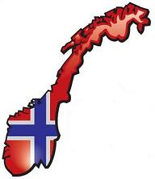
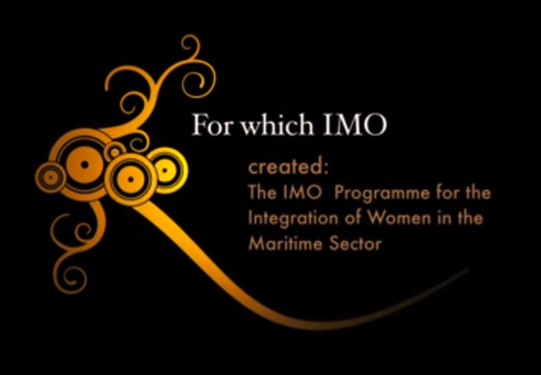
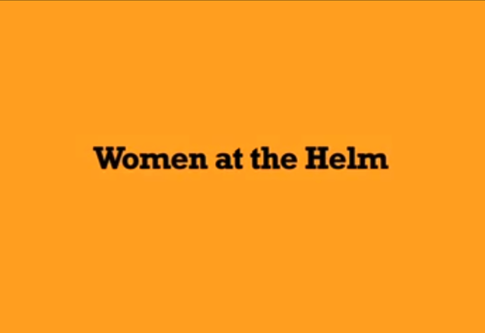
How to do it?
Norway passed a law in 2003 requiring that 40% of all company board members be women. By 2010:
400 companies had over 40% female directors
65 companies had over 25% of women on board seats
Netherlands, Spain, France are joining efforts
In 2013, IMO celebrated the 25th anniversary of its Programme for the Integration of Women in the Maritime Sector

Slide 9
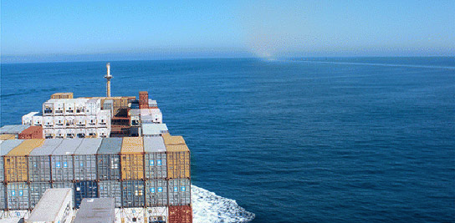
Methodology & Study Design

Slide 10
Relative few studies on measuring perceptions and attitudes of management and executive-level women
Sent survey to the WISTA membership via WISTA’s secretary
Operationalized WARS construct through questions
Population of female maritime professionals from WISTA (1,027 in 33 countries):
WISTA focus on networking, education and mentoring to enhance its members competence and empower career success
Didn’t measure actual compensation and other factors but rather measure the perceptions
Response rate 20.541% from all 33 countries
Analysis of differences in attitudinal and structural perspectives

Slide 11
Results

Slide 12
Pearson Correlation Matrix (Phi coefficient)
Ranges from -1 to 1:
1 is perfect positive correlation
-1 is perfect negative correlation
0 indicates no relationship
All constructs have weak or little relationship
The measure of the constructs of wealth, appreciation, risks and sacrifice are separate and distinct
Pearson Correlation Matrix
 | Wealth | Appreciation | Risk | Sacrifice
Wealth (Adequately compensated) |  | 0.23124157 | -0.103185 | 0.04025242
Appreciation (by company) |  |  | -0.203139 | 0.11510416
Risk (Challenges) |  |  |  | -0.1861225
Sacrifice (Gender Issues)

Slide 13
Demographics of Respondents
Level of Education
Table 2
Demographics of Respondents
Primary caregiver to children or other relatives |  | 41%
Relative who worked in maritime industry |  | 27%
Raised near a port |  | 44%
Number of years worked in the industry |  | 14.4347626
Table 3
Level of Education
 | pre college | 11%
 | some college | 6%
 | university degree | 34%
 | post bachelor degree | 49%

Slide 14
Sectors of the Industry Represented
Wealth and Compensation
Sectors of the industry represented | Deck | 3%
 | Engine | 0%
 | Other ship | 5%
 | Ship owner | 13%
 | Cruise staff | 1%
 | Ship broker | 2%
 | Ship Insurance | 3%
 | Maritime Law | 18%
 | Multiple roles | 54%
Wealth and Compensation
Adequately Compensated |  | 59%
Comparable to Male Counterparts |  | 49%
Necessary Resources |  | 67%

Slide 15
Appreciation and Recognition
Risk and Negative Consequences
Appreciation and Recognition
Feel Appreciated by Industry |  | 80%
Feel Appreciated by Company |  | 75%
Risk and Negative Consequences
Additional Risk with a maritime career |  | 60%
Sufficient Mentoring in the industry |  | 27%
Sufficient Mentoring in your company |  | 45%
Mentoring is helpful |  | 48%
Sufficient Networking in the industry |  | 54%

Slide 16
Sacrifice and Job Satisfaction
Sacrifice and Job Satisfaction
Industry does address Gender-related issues |  | 24%
Company does address Gender-related issues |  | 52%
Current Workweek sustainable |  | 61%
Schedule more important than compensation |  | 59%

Slide 17
Recruitment issues
Education about the industry
Not always familiar through family or location
Explain how gender issues are addressed

Slide 18
Retention issues
Highly Educated Group
Professionalism
Entrepreneurship
Comparable pay and resources to men
Sufficient mentoring needed
Address gender issues
Lifestyle/ schedule paramount
Reduce career risk

Slide 19
Curricula Changes Needed
Emphasis on laws on equitable pay, promotion and equal opportunity
Present evidence that diversity leads to better company performance
Emphasize the need for high levels of education
Include additional law courses
Entrepreneurship or multiple roles concepts
Emphasize open mentoring systems and advantages
Emphasize networking systems and advantages
Address gender-related issues head-on

Slide 20
Conclusions

Slide 21
Recruiting and retaining women executives to the maritime industry requires a tool set that addresses gender issues
Maritime women are well educated
Not all perceive their compensation to be equitable to their male counterparts
Women feel appreciated
Know that a maritime career can have negative consequences for success
Companies should take note of the lack of perceived mentoring (and sponsoring) for women executives
Women believe they can sustain a long and successful career if specific, identifiable strategies from the industry leadership are forthcoming

Slide 22
Q&A
ANA M. ALBERT

