Slide 1
Port Productivity and the Current effects of larger vessels
Brendan Neary
Project Manager
JOC Group Inc.
Maine Maritime Academy| Castine, Me
October 18, 2014

Slide 2
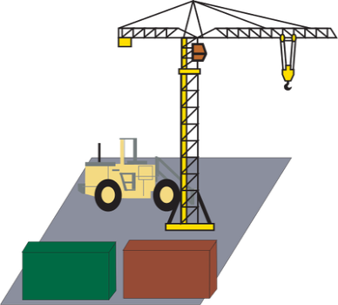
Berth productivity and Our Data Set
The productivity measures in this dataset are based on seven elements provided by ocean carriers representing more than 75 percent of global capacity. Those data points are:
vessel name
terminal name
port city
port country
berth arrival
berth departure
total number of moves (including lift-ons, lift-offs and re-stows).
Berth arrival and departure refer to “lines down” and “lines up” — that is, the actual arrival and departure of the ship at berth. The calculation of moves per hour between these two times is referred to as unadjusted gross berth productivity.

Slide 3
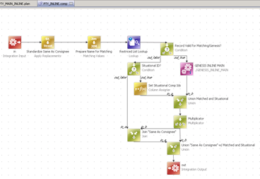
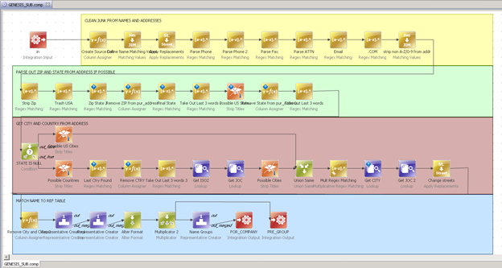
Once data is Received it’s Cleansed
Examples of the JOC 6 Step Process:
Structuring: Commodity codes are parsed and put into a format that can then be matched against a dictionary.
Standardizing: Port names are standardized to be consistent (example: NY, N. York, New York all become New York).
Validating: Vessel dates, ports, and dock names are added from a secondary data source (Customs logs).
Coding: HS codes and port codes are assigned.
Calculating: TEU Values are calculated, ESTIMATED VALUE is calculated.
Enhancements: Additional company information, such as address is added when possible.

Slide 4
Number of Records
Vessel Calls
Row Labels | 1H 2012 | 2H 2012 | 1H 2013 | 2H 2013 | 1H 2014 | TOTAL
East Coast/Gulf North America | 2,537 | 2,320 | 3,917 | 3,993 | 3,275 | 16,042
Latin America | 5,551 | 4,211 | 9,110 | 9,431 | 8,502 | 36,805
Mediterranean Region | 8,177 | 5,195 | 10,205 | 11,297 | 10,010 | 44,884
Middle East/Africa | 3,136 | 2,973 | 7,000 | 7,058 | 5,661 | 25,828
North Asia | 9,966 | 7,328 | 21,335 | 22,773 | 20,792 | 82,194
North Europe | 4,748 | 3,669 | 7,601 | 8,474 | 7,150 | 31,642
South/South East Asia | 14,433 | 10,505 | 11,389 | 12,825 | 10,810 | 59,962
West Coast North America | 1,383 | 1,202 | 1,795 | 1,863 | 1,543 | 7,786
TOTAL | 49,931 | 37,403 | 72,344 | 77,722 | 67,743 | 305,143
- Continued growth with a successful 2013 data collection year
- Our data set is not only expanding in carriers and vessel calls but also our global coverage
Ports
Row Labels | 1H 2012 | 2H 2012 | 1H 2013 | 2H 2013 | 1H 2014 | TOTAL
East Coast/Gulf North America | 19 | 19 | 19 | 19 | 17 | 20
Latin America | 75 | 75 | 96 | 97 | 90 | 99
Mediterranean Region | 59 | 56 | 83 | 86 | 80 | 88
Middle East/Africa | 50 | 60 | 76 | 79 | 71 | 87
North Asia | 28 | 31 | 51 | 50 | 50 | 53
North Europe | 32 | 30 | 63 | 61 | 62 | 65
South/South East Asia | 60 | 58 | 59 | 63 | 59 | 68
West Coast North America | 9 | 10 | 11 | 11 | 11 | 12
TOTAL | 332 | 339 | 462 | 470 | 440 | 492
Terminals
Row Labels | 1H 2012 | 2H 2012 | 1H 2013 | 2H 2013 | 1H 2014 | TOTAL
East Coast/Gulf North America | 32 | 28 | 36 | 34 | 32 | 39
Latin America | 100 | 100 | 125 | 126 | 119 | 133
Mediterranean Region | 85 | 77 | 108 | 111 | 103 | 116
Middle East/Africa | 58 | 68 | 90 | 92 | 84 | 104
North Asia | 94 | 87 | 141 | 138 | 140 | 147
North Europe | 62 | 58 | 97 | 100 | 96 | 104
South/South East Asia | 99 | 91 | 92 | 99 | 93 | 103
West Coast North America | 27 | 23 | 30 | 31 | 26 | 34
TOTAL | 557 | 532 | 719 | 731 | 693 | 780

Slide 5
Current trends in productivity
Vessel Size per Region | 1H 2013 Berth Productivity | 1H 2014 Berth Productivity
Americas | 78 | 62
2,500 or Less | 45 | 37
2,501 to 5,000 | 66 | 52
5,001 to 7,500 | 83 | 66
7,501 to 10,000 | 101 | 82
10,000 & Over | 116 | 104
Asia/Pacific | 78 | 88
2,500 or Less | 45 | 49
2,501 to 5,000 | 66 | 71
5,001 to 7,500 | 85 | 87
7,501 to 10,000 | 102 | 109
10,000 & Over | 113 | 121
EMEA | 78 | 71
2,500 or Less | 45 | 38
2,501 to 5,000 | 65 | 55
5,001 to 7,500 | 85 | 81
7,501 to 10,000 | 101 | 92
10,000 & Over | 115 | 107
Severe drop in productivity for Americas and Europe/ Middle east
Asia Pacific increases productivity through every vessel size
Globally, productivity has dropped for each vessel size with the exception of 10,000 and over.
Vessel Size | 1H 2013 Berth productivity | 1H 2014 Berth productivity
2,500 or Less | 45 | 43
2,501 to 5,000 | 65 | 62
5,001 to 7,500 | 84 | 80
7,501 to 10,000 | 102 | 99
10,000 & Over | 114 | 115

Slide 6
mega-ship delays are growing

Slide 7
Container ship sizes continue to grow
Growth of ship size accelerates 1.2 percentage points in 10 years, moreso recently
Underlying cause of growing congestion at ports worldwide that are not fully equipped to deal with volume surges

Slide 8
BIGGER SHIPS IN EVIDENCE AT SUEZ CANAL

Slide 9
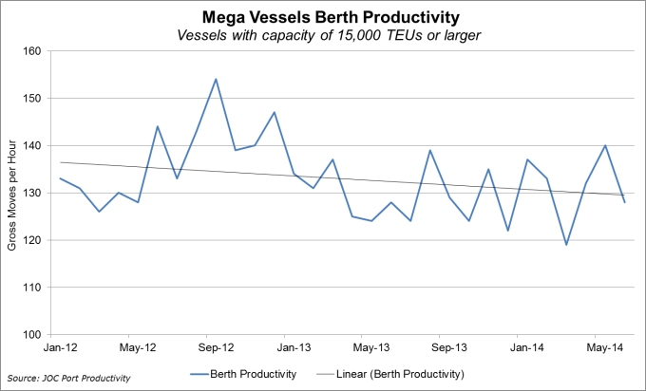
Mega Vessel Expansion at a cost
Number of Mega ships increase as time goes on
Productivity across these vessels is decreasing over time

Slide 10
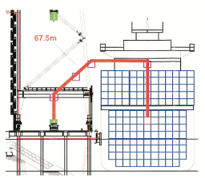
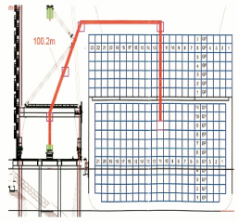
Crane productivity suffers
Panamax Vessel
5,000 TEUs
13 across
5 containers above deck
The 42 moves per hour theoretical crate rate maximum is reduced to 25-35 moves per hour under real life conditions
Traveling distances increase by an average od 47% for mega vessels
Mega vessels take up quay capacity and challenge productivity
Collaboration/dialog with Alliance carriers is required
Triple E Vessel
18,000 TEUs
23 across
7 containers above deck
Deck level is 7m higher than Panamax

Slide 11
Recent Solutions To Evergrowing issue
JOC.COM - Long Beach enters 'crisis mode' to attack congestion by Bill Mongoluzo
The port last week established a Chassis Relief Team that held its first meeting with Direct ChassisLink, cargo interests, terminal operators and truckers. DCLI, one of the three major chassis leasing companies in the harbor, agreed to take the lead in working with the other providers to publish regular updates on chassis positioning throughout the port complex.
JOC.COM - Georgia plans additional inland terminals by Joseph Bonney
Foltz said inland terminals provide opportunities for economic development and transportation efficiency by encouraging intermodal shipments and taking pressure off crowded highways. “This is all about servicing commerce in a more efficient, diverse and sustainable manner for the long term,” he said.

Slide 12
Thank you
Follow us on Twitter:
@JOC_Updates
@TPMConferences
Subscribe to JOC.COM:
Discount Code – JOCBN20

